Slide 1
QST for phase 2 trials
Long-term neuropathic and non-neuropathic conditions
Per Hansson, MD, DMSci, DDS
Karolinska Instituet, Karolinska University Hospital
Stockholm, Sweden

Slide 2
QST as a tool for phenotyping in phase 2 studies
Predictors---Quantify multiple parameters, painful and non-painful to look for one/many that may predict treatment success/failure (affected or unaffected by the treatment). Wide angle approach, post hoc analysis and then phase 3 study with selected parameters (a priori hypothesis).
Parameters (part of the phenotyping!) which are part of the suffering to monitor alleviation (dma, sma, (cold allodynia))
Remote area testing to identify cognitive-emotional pain related hypersensitivity (not central sensitization!). Only pain parameters. Implications for treatment?

Slide 3
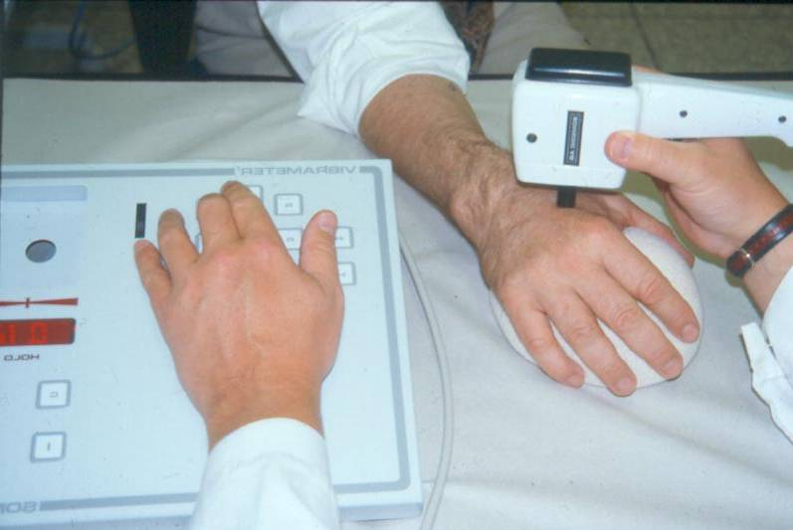
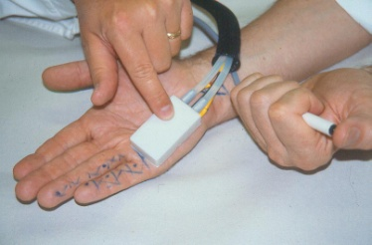
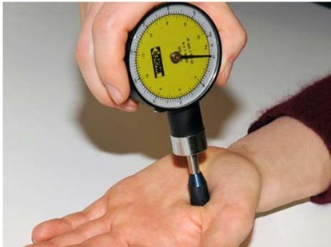
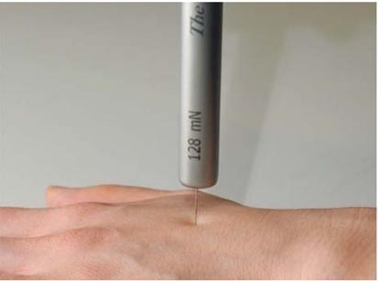
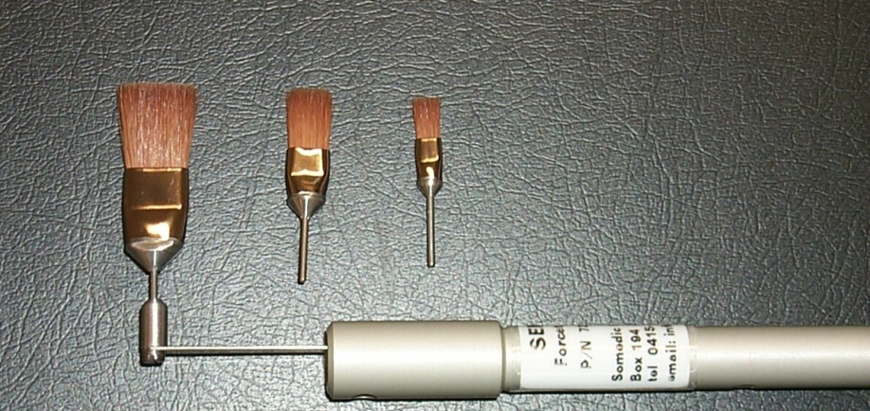
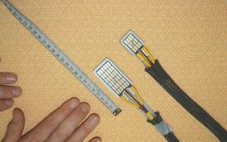
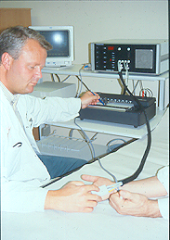
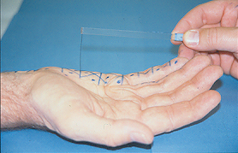
Physiological/natural stimuli
Hansson et al. 2007

Slide 4
-Electrical stimulation
-CO2 laser-, Yag laser stimulation
-Dipole stimulation
-Tension of gi tract

Slide 5
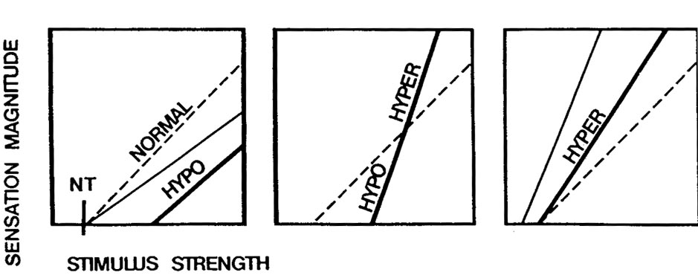
QST principles
The QST approach is based on:
-precise definition of the stimulus properties (modality, intensity, spatial and temporal characteristics)
-analysis of the quality of the evoked sensation
-quantification of the intensity of the evoked sensation
-perception thresholds assessment as well as magnitude estimation of suprathreshold stimuli (s-r function)
-presentation of stimulus-algorithm (method of limits, levels, staircase etc)

Slide 6
What QST can assess
-Large/DC-thalamo-cortical pathway and small fibre/spino(trigemino)-thalamo-cortical pathway function
-Site specific “static” data for the most and not the dynamic spatial summation properties of somatosensory systems (sometimes different outcome compared to bedside exam)
-Pain perception as a function of repetitive stimulation
-Group mean data for research purposes
-Individual clinical assessment
-Course of disease

Slide 7
What QST cannot assess
-Level of lesion or disease
-Spatial extension of somatosensory dysfunction
-True minimum pathology on an individual basis (the battle between side comparison vv normative data)
-Difference between true neuropathy and sensory alterations depending on other conditions-no single pathognomonic aberration or pattern in neuropathy.
-Underlying pain pathophysiology, e.g., peripheral or central sensitization
-Best choice of pain treatment

Slide 8
Neuropathic pain
(PNeP and CNeP)

Slide 9
Also-----Non-painful spontaneous/evoked phenomena, i.e., paresthesia, dysesthesia.

Slide 10
What has been published so far on QST as efficacy parameter/predictor?

Slide 11
Effects were found on dynamic mechanical allodynia (5 trials), pinprick hyperalgesia (1 trial) and sensory loss (4 trials).
Treatment efficacy was predicted by thermal detection thresholds (2 trials) vibration detection thresholds (2 trials), heat hyperalgesia (1 trial) and dynamic mechanical allodynia (1 trial)…….. However, the relevance of QST to predict therapeutic outcome has yet to be established in prospective studies.
Haanpää et al. 2011

Slide 12
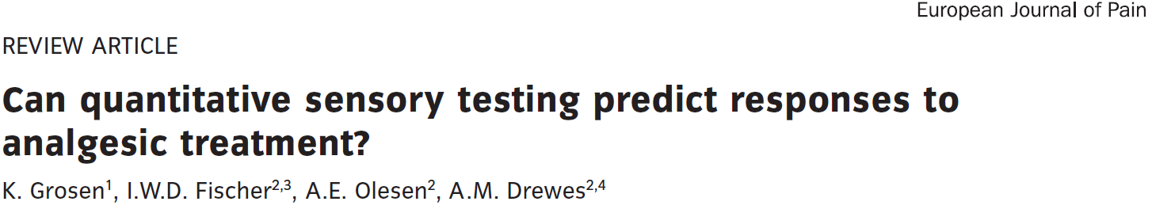
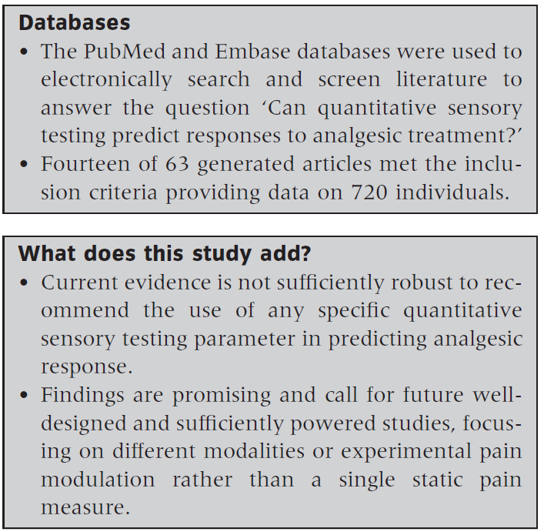
2013
4 studies included on chronic pain (Attal et al., 2004; Edwards et al., 2006; Yarnitsky et al., 2012; Olesen et al., 2013).

Slide 13
Mechanical allodynia

Slide 14
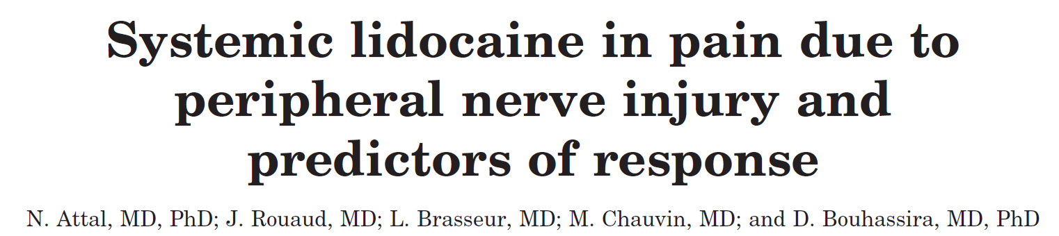
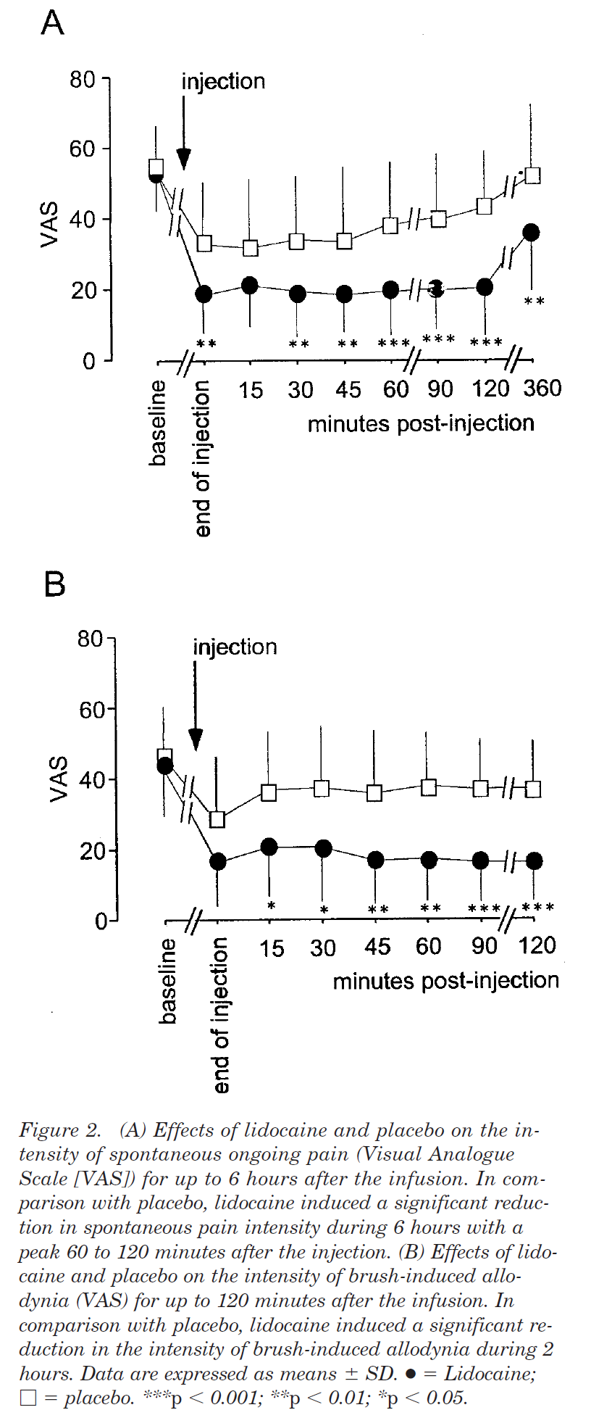
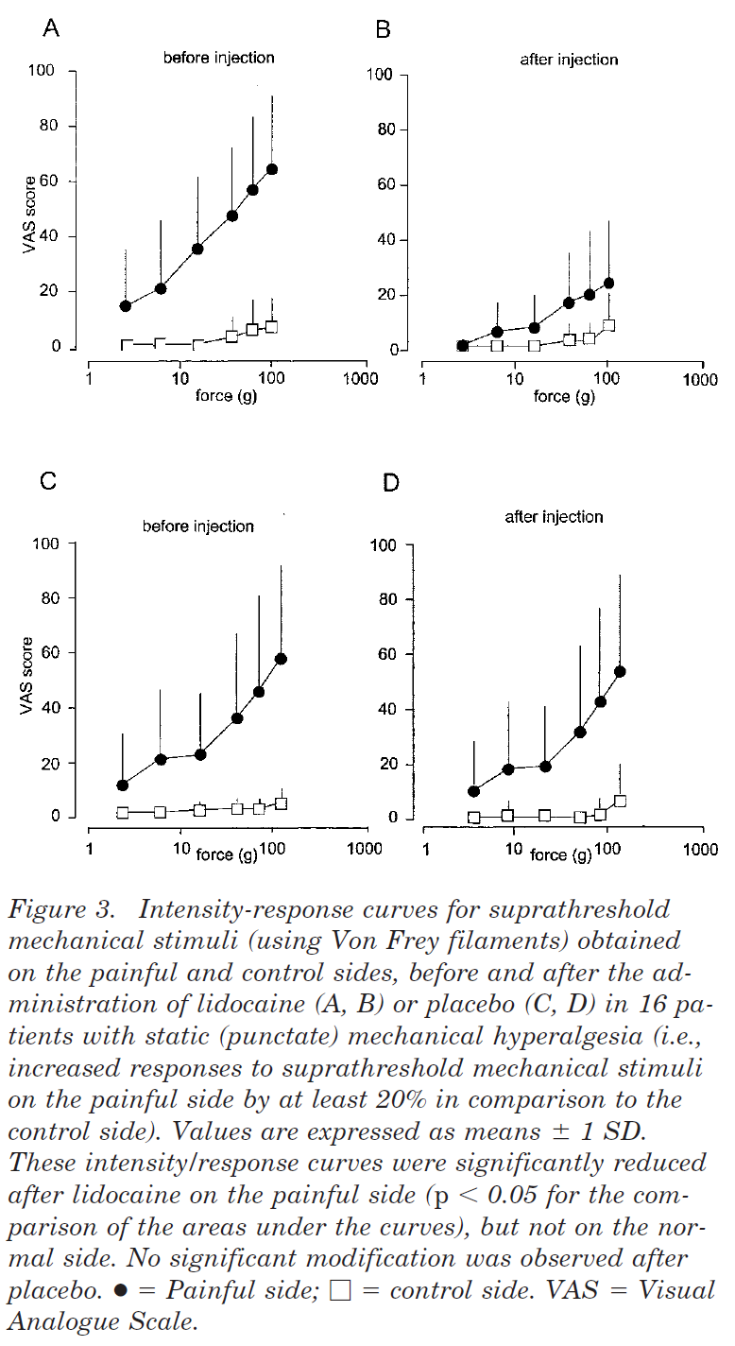
Tactile allodynia (dynamic) was investigated before injection, every 15 minutes up to 60 minutes postinjection, and 90 and 120 minutes postinjection, using a paintbrush (three movements).
2004

Slide 15
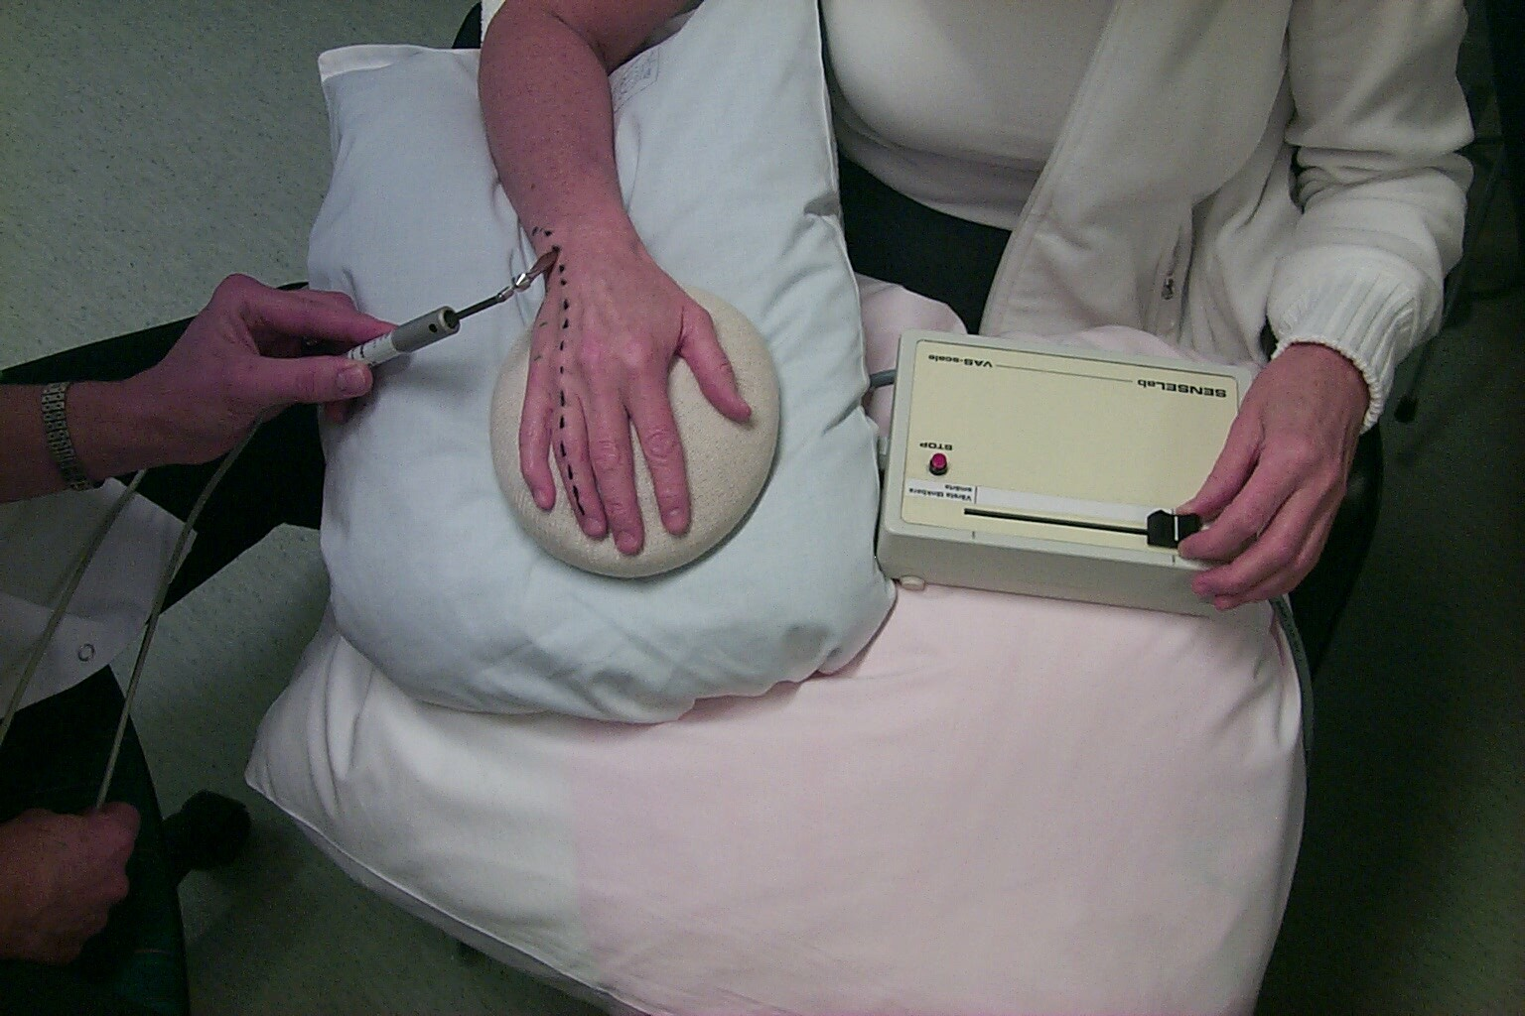
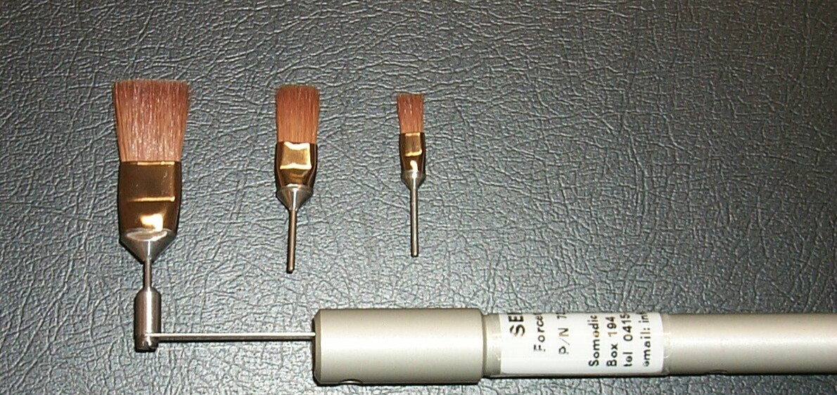
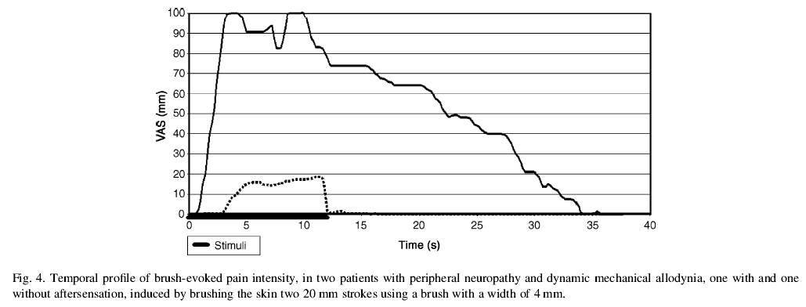
start
20 mm (2 or 4 times)
Recording of VAS ratings of pain intensity during stimulation=dynamic VAS, calculating AUC=total dynamic VAS (td VAS)
40 mm
60 mm
Samuelsson, Leffler & Hansson, 2005, 2007, 2011
Landerholm & Hansson, 2010
”Constant” brushing pressure (4-25 g, visual feed back) and speed (10-30 mm/s)
16 mm 8 mm 4 mm

Slide 16
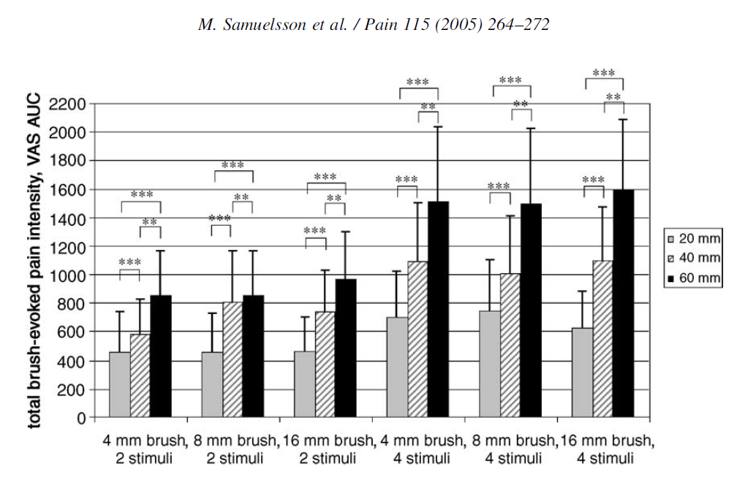
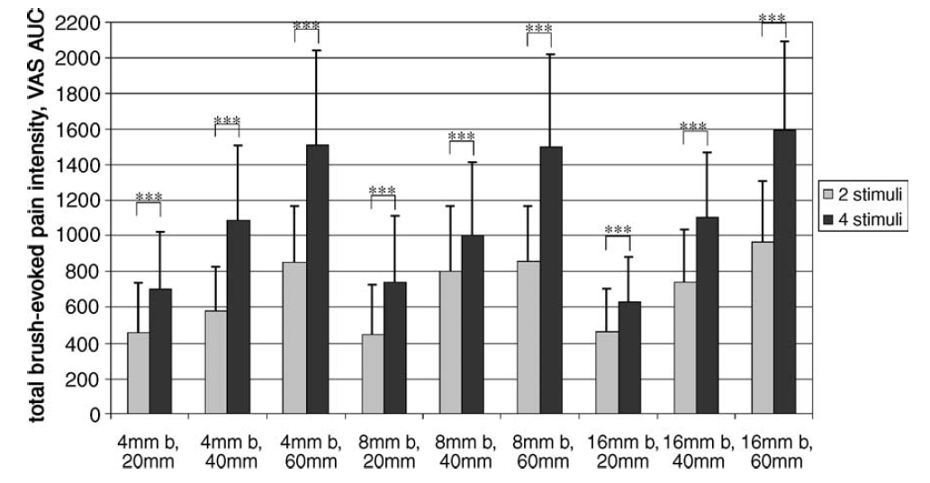
Significantly increased total brush evoked pain intensity was demonstrated with increased brushing length and number of strokes (P<0.001), but not while altering brush width.

Slide 17
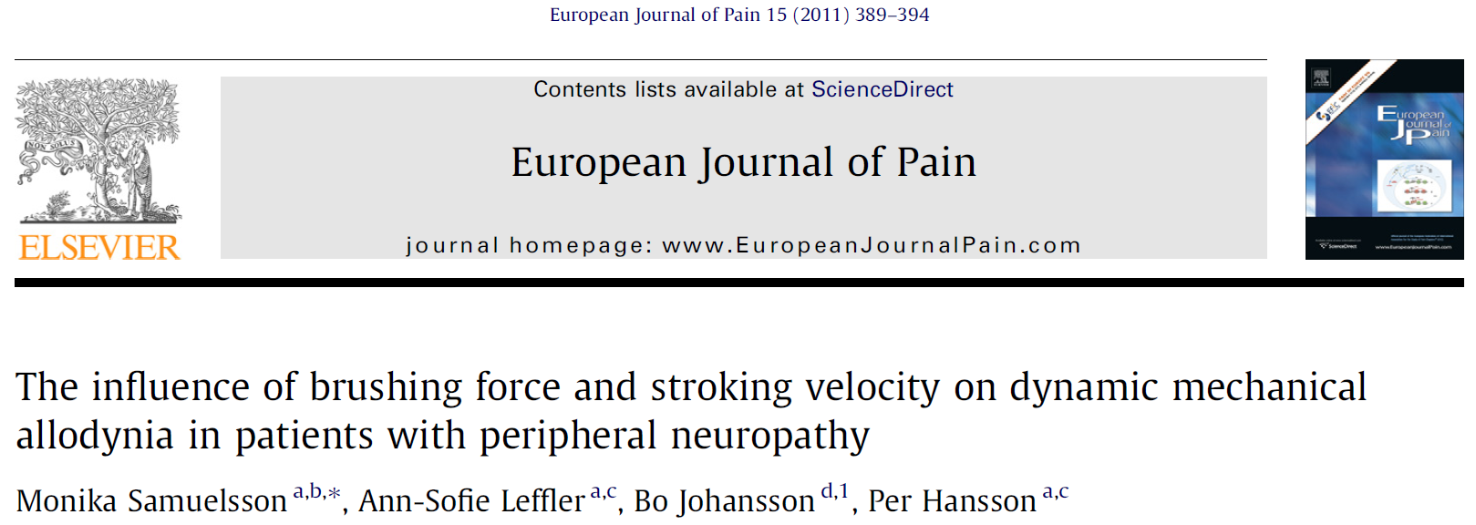
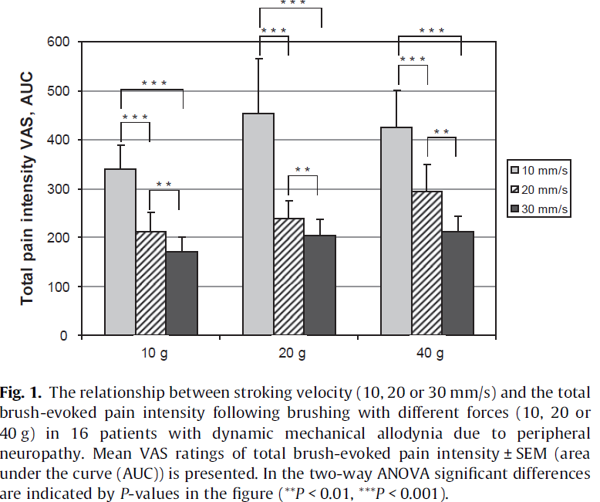
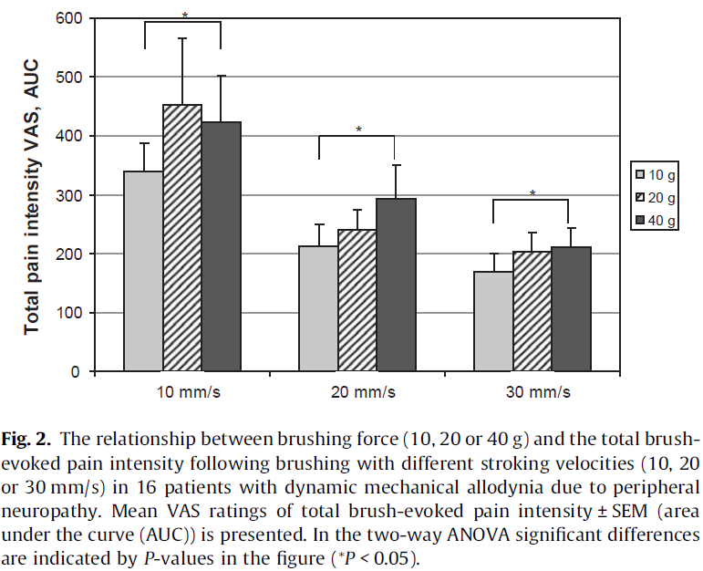
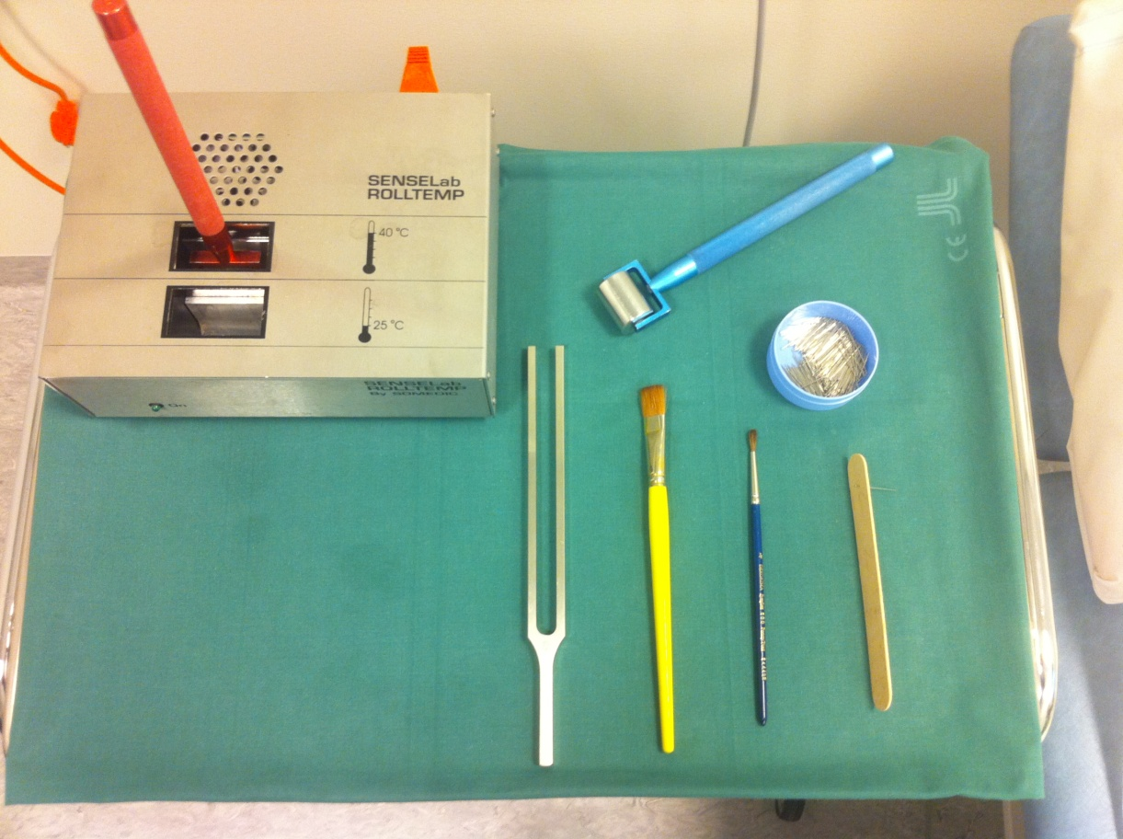
Significantly increased total brush-evoked pain intensity was demonstrated with lower stroking velocity (P < 0.001) and higher brushing force (P < 0.05).

Slide 18
Area of allodynia and hyperalgesia (although not QST)

Slide 19
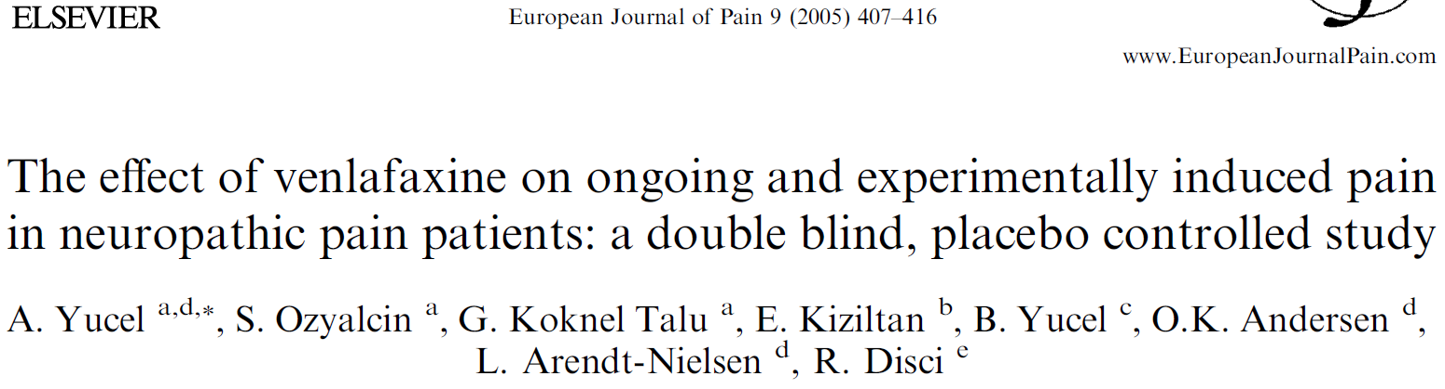
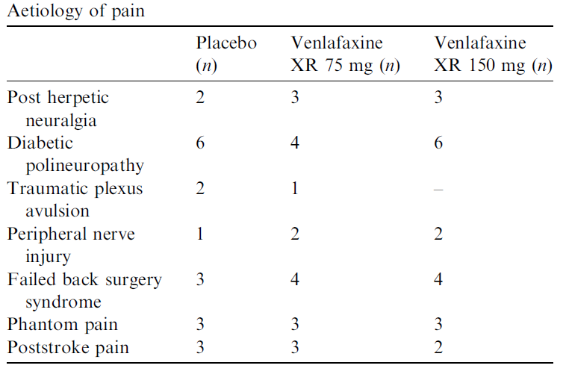
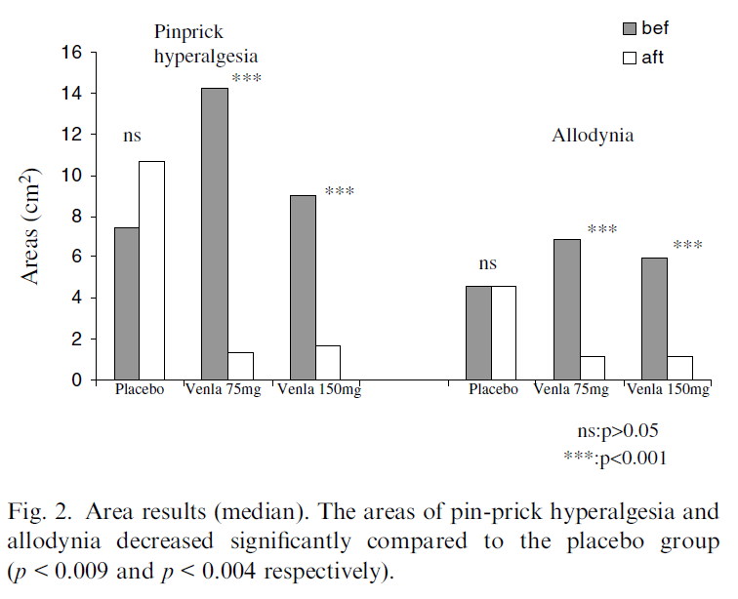

Slide 20
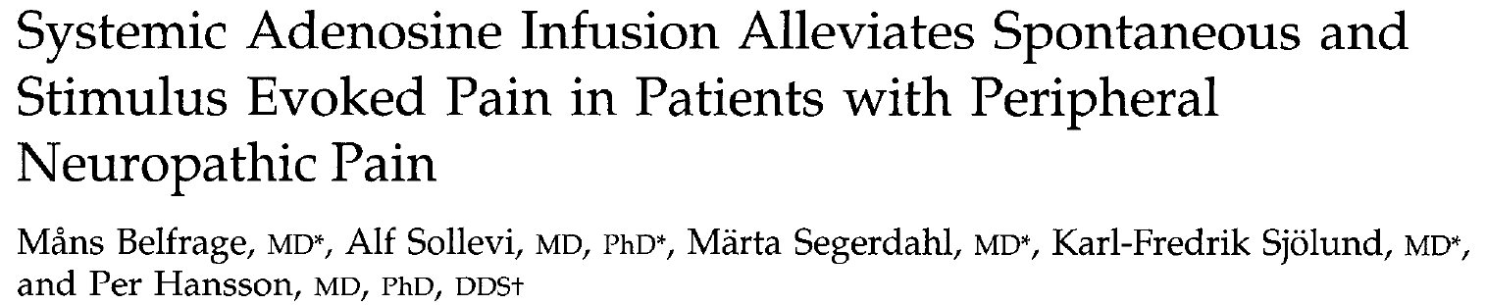
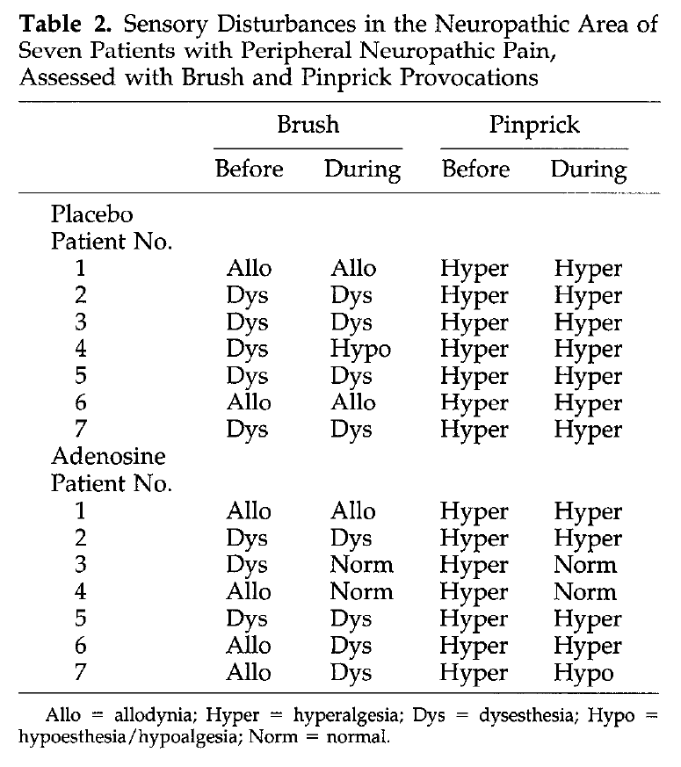


Slide 21
Prediction and neuropathic pain

Slide 22
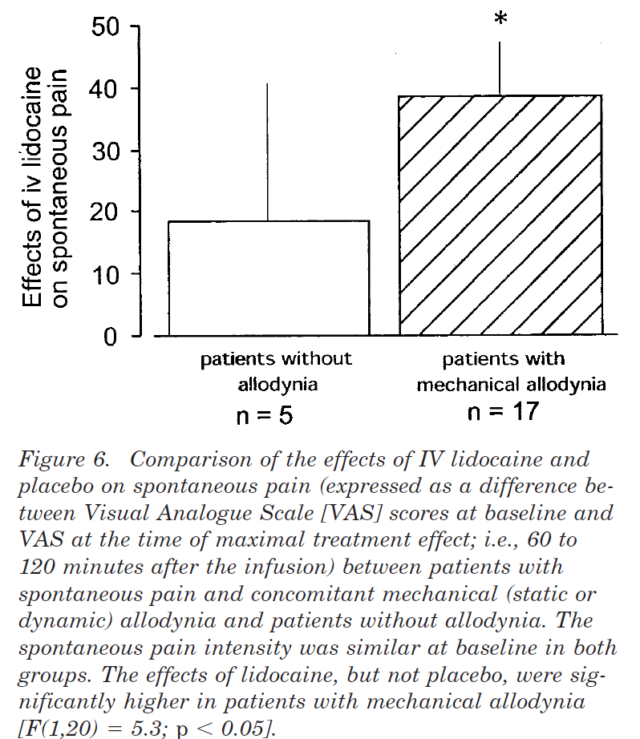
Tactile allodynia (dynamic) was investigated before injection, every 15 minutes up to 60 minutes postinjection, and 90 and 120 minutes postinjection, using a paintbrush (three movements).
2004
…..two thirds of patients with spontaneous pain and concomitant mechanical allodynia were responders to lidocaine (at least 50% relief), whereas there was no responder in those with pure spontaneous pain.

Slide 23
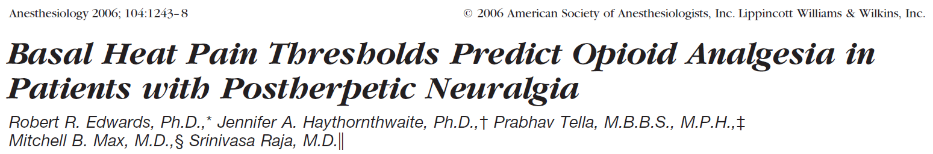
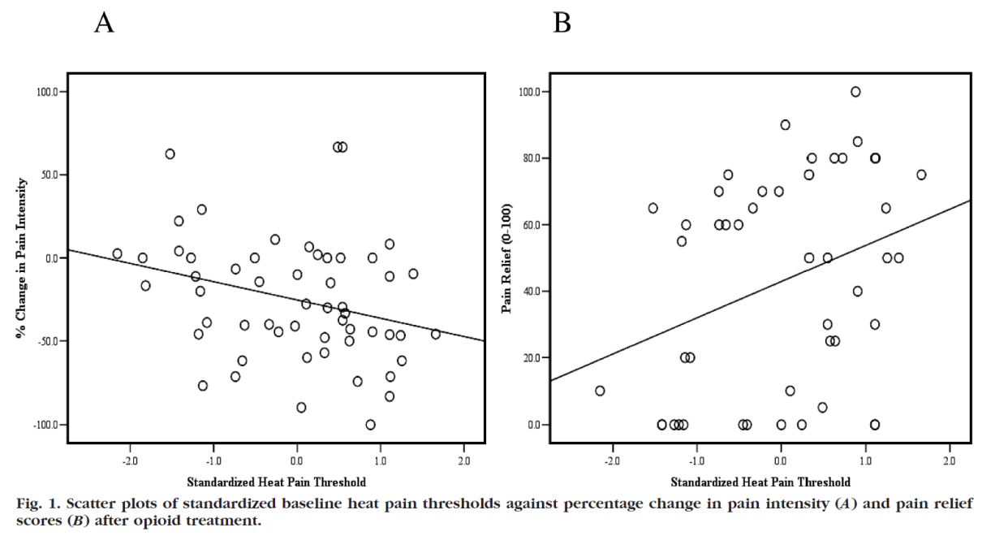
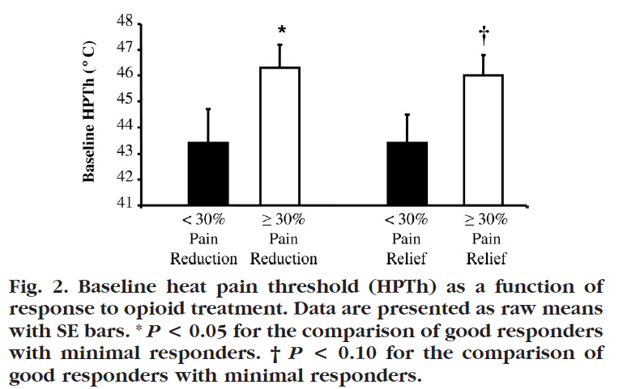
Contralateral HPT!
During opioid treatment, a greater reduction in pain and higher ratings of pain relief were observed in patients with relatively higher heat pain thresholds at baseline.

Slide 24
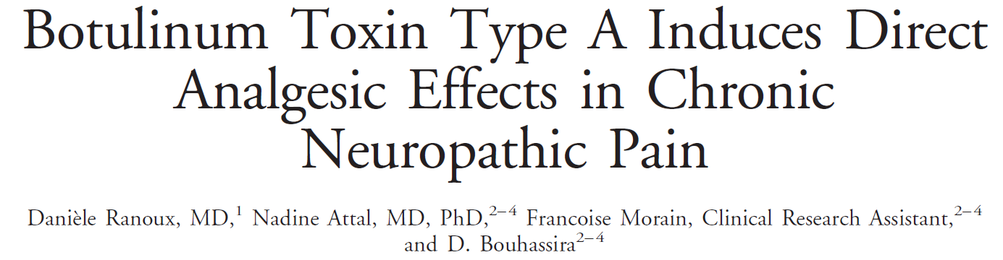
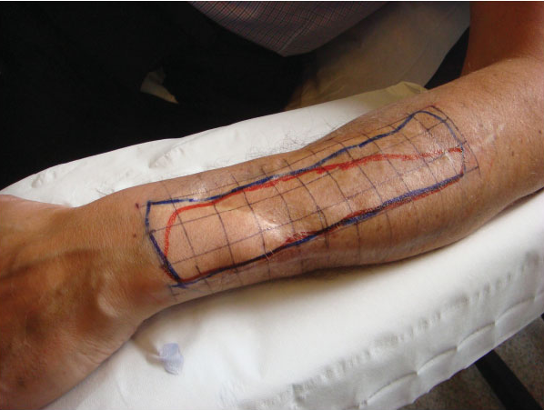
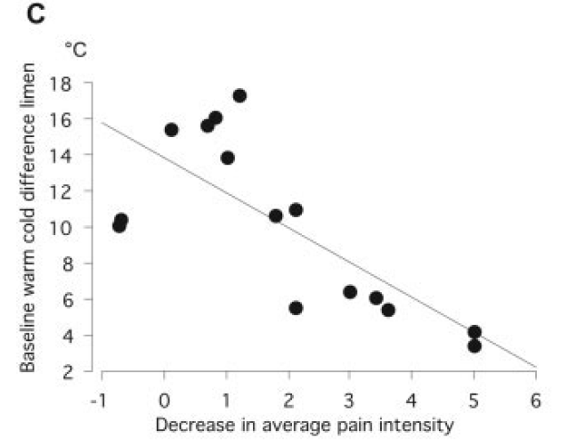
Less deficit better response
Correlation between the baseline severity of thermal deficits (expressed as the difference between warm and cold detection thresholds on the painful side) and the effects of BTX-A on weekly average pain intensity assessed from pain diaries at 12 weeks (expressed
as the difference between pain intensity at baseline and 12 weeks). Rho =0.69; p =0.009.

Slide 25
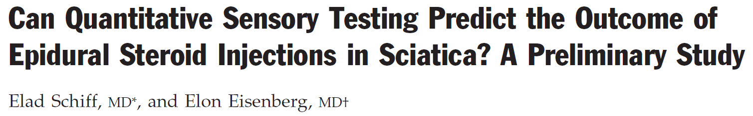
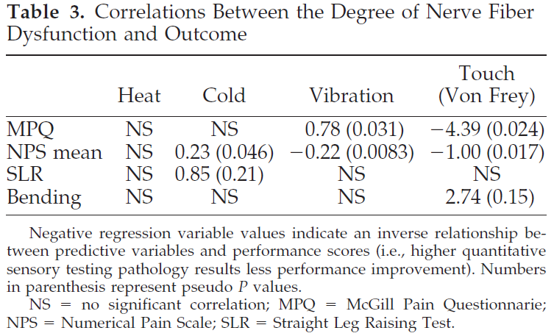
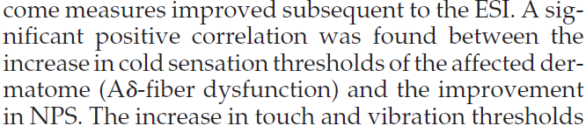
2003
The increase in touch and vibration thresholds (A-fiber dysfunction) was found to be inversely correlated with the improvement in NPS.

Slide 26
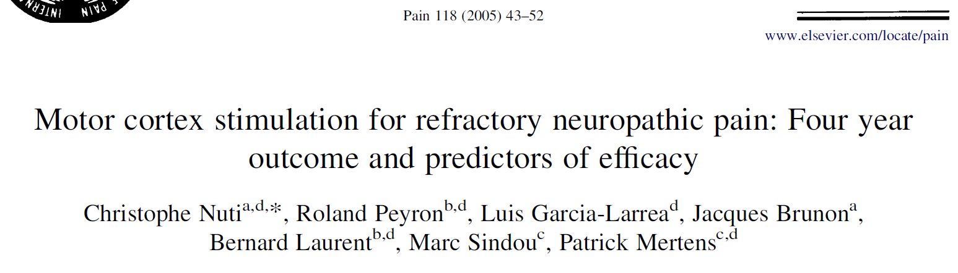
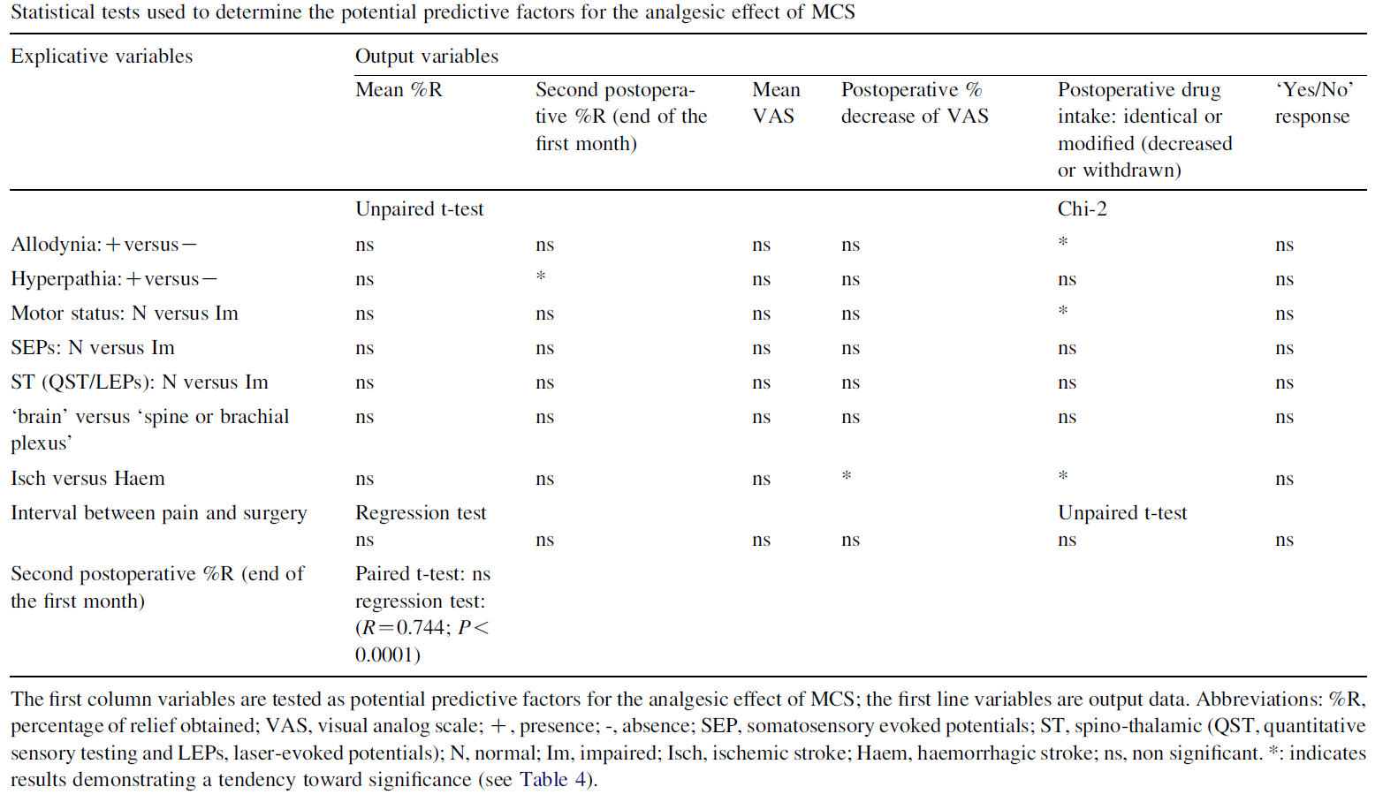
WT, CT, HPT, CPT in painful area and outside.
Quantitative sensory testing did not predict the efficacy of MCS.
““Good” responders (>40%) to MCS could be identified by the absence of alteration of non-nociceptive sensory modalities within the painful area, or by abnormal sensory thresholds that could be improved by MCS.”
See however Drouot et al. 2002 on MCS assessing WT, CT, HPT, CPT and VDT

Slide 27
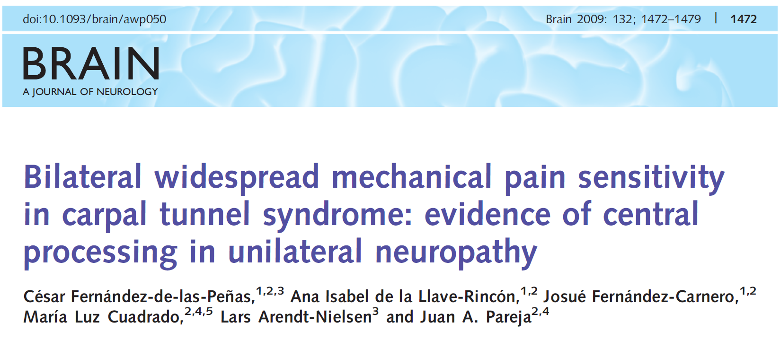
Remote hypersensitivity. What does it mean?

Slide 28
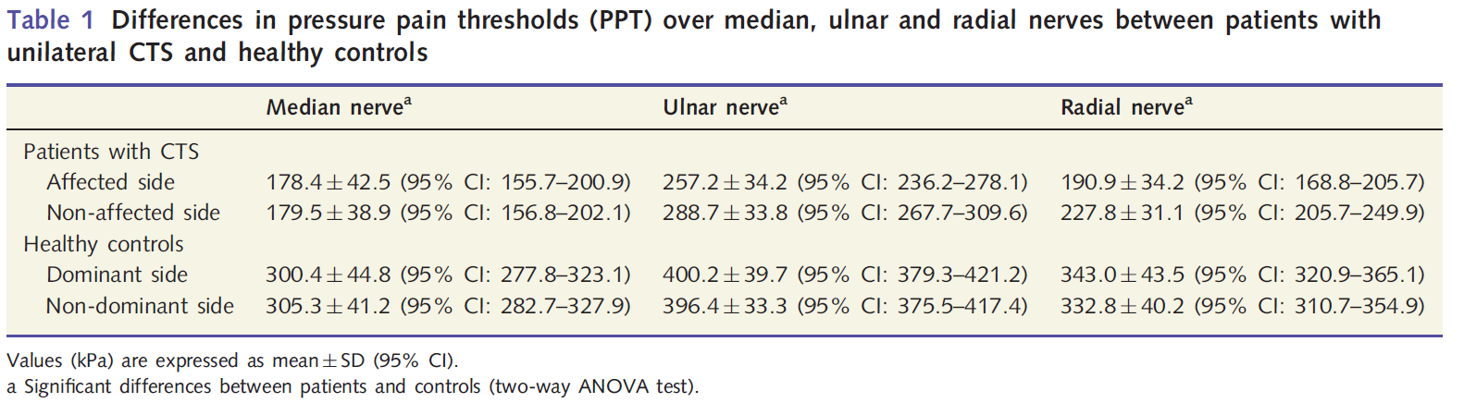
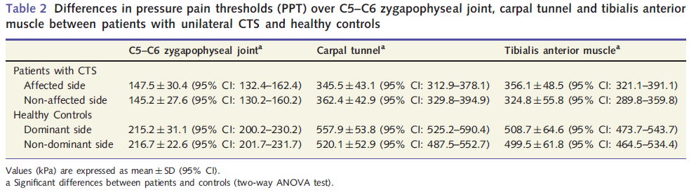
et al., 2009

Slide 29

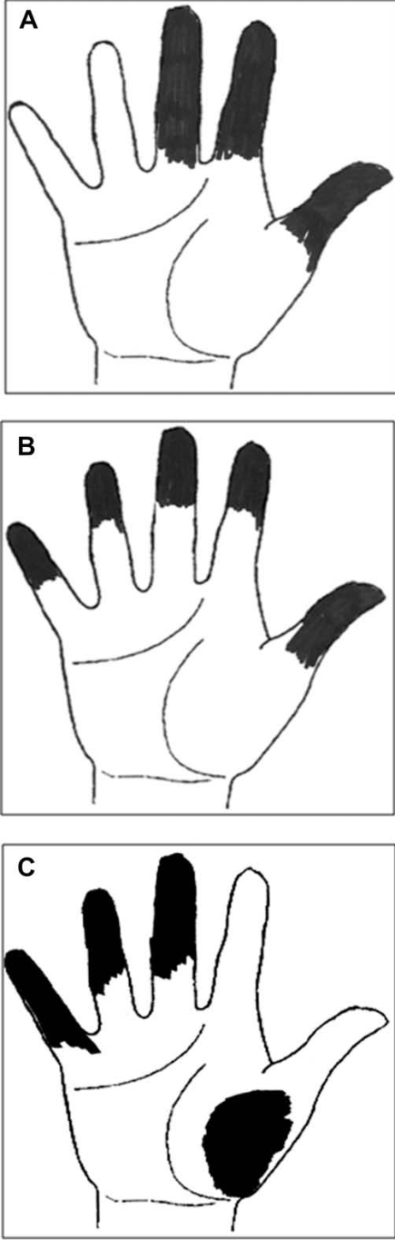
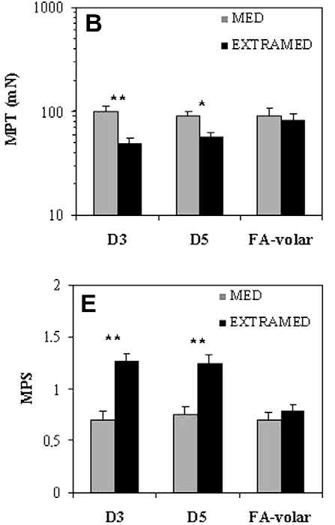
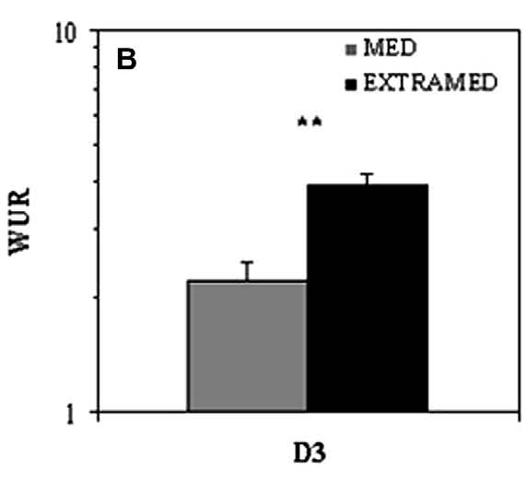
2010
Nearby hypersensitivity-spread outside proper innervation territory
QST signs of sensitization in patients with extramedian symptoms only

Slide 30
--Non-anatomical distribution of neuropathic pain may reflect CNS plasticity rather than psychopathological disorders or malingering
--Spinal changes may play a major role in the spread of pain
--Central sensitization may also provide a pathophysiological explanation: 1/ secondary to activity in median nerve afferents 2/ consequences of a predisposing trait
--Peripheral and supraspinal mechanisms may contribute
Zanette et al. 2010

Slide 31
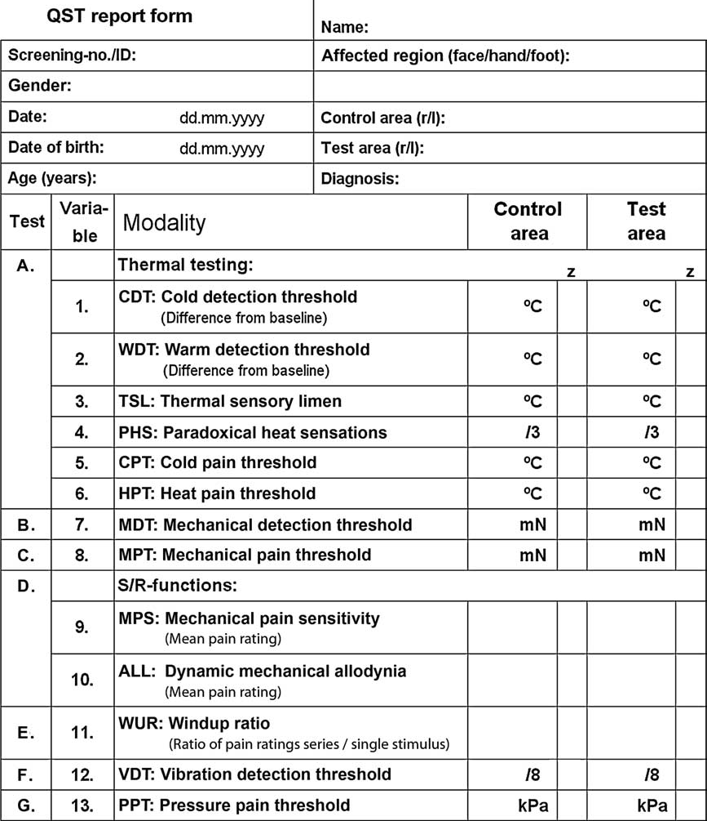
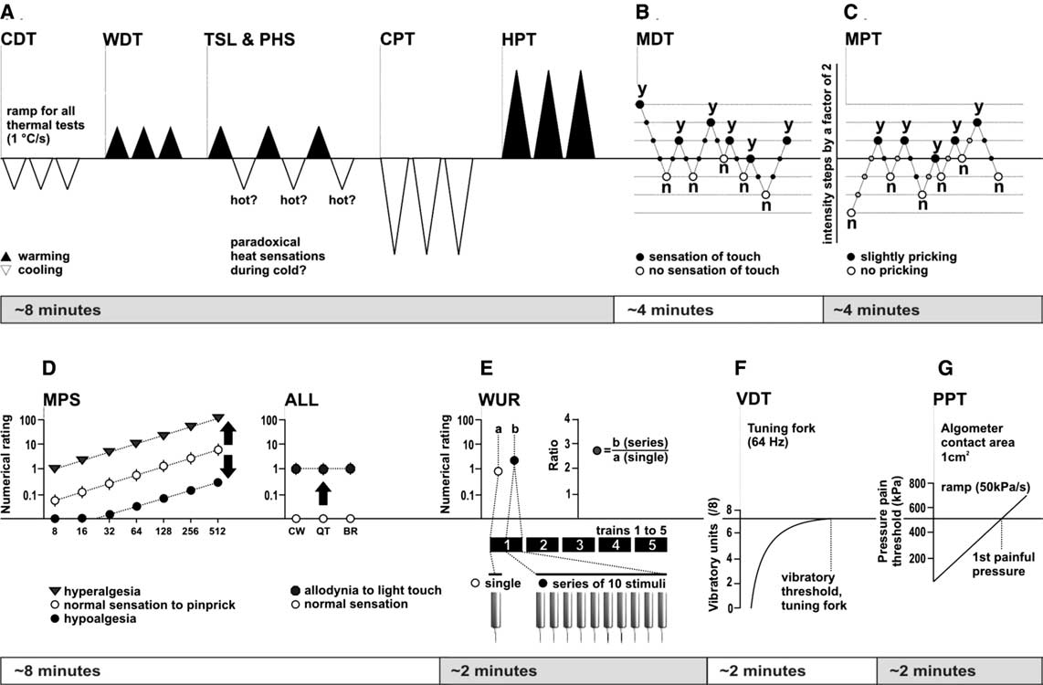
QST techniques and approach-
Copy German Network? Dilute?
Rolke et al. 2006

Slide 32
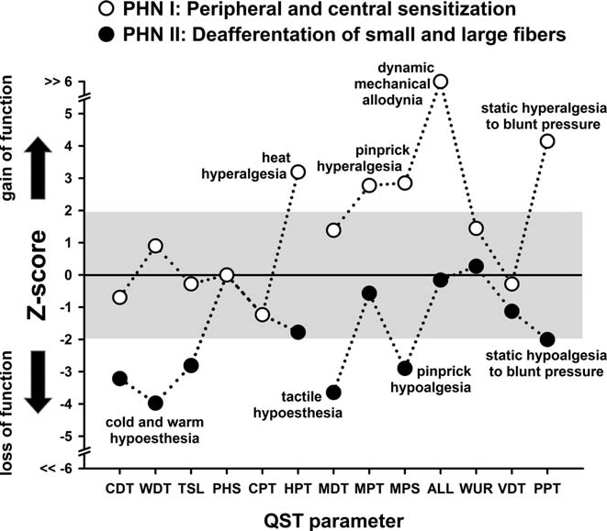
What is pathological?
If a reading is compared with normative data (lab. specific, DFNS) and found to be within the normal range a threshold may still be suspected to be pathological if compared with the unaffected side!
Hugh normal range for some parameters (e.g., HPT, CPT-see DFNS).
Also, only 3 reference sites are used within the DFNS!!

Slide 33
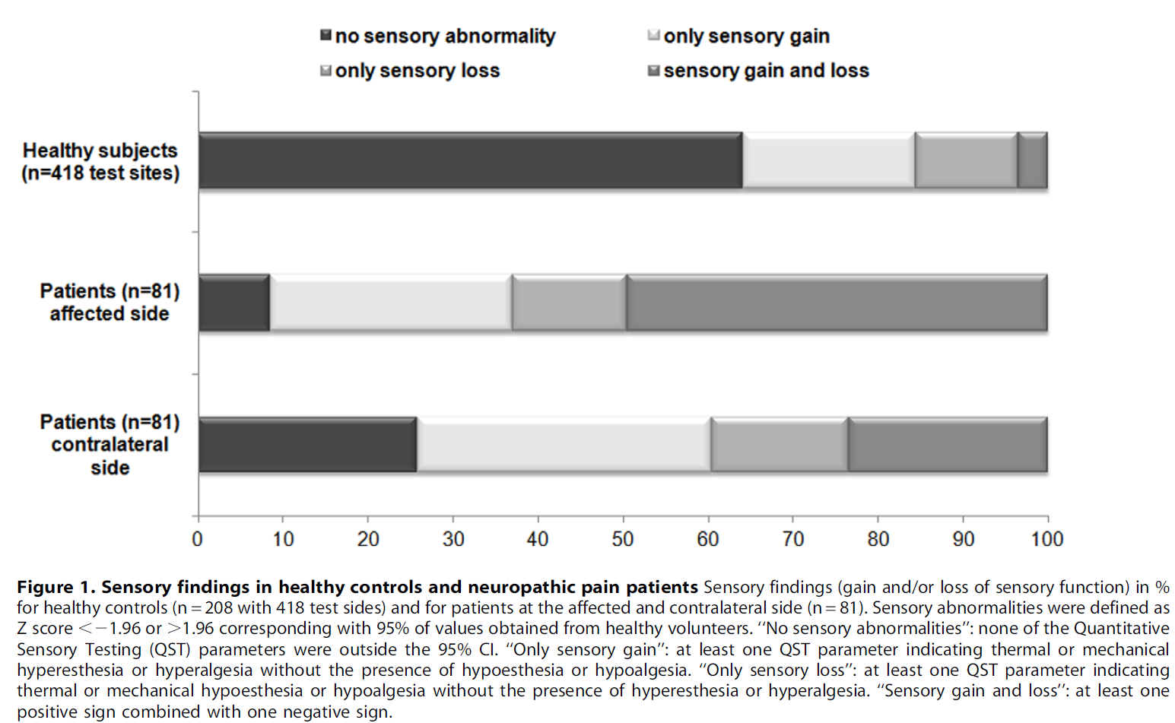
Contralateral side normal in NeP?
Once a sensory abnormality for a QST parameter at the affected side was observed, the prevalence of an abnormality for the same parameter at the non-affected side was as high as 57% (for Pressure Pain Threshold).
Konopka et al. 2012

Slide 34
Inflammatory/nociceptive pain
(OA, LE,CTTH, Pancreatitis)

Slide 35




Skin not optimal?
Deep tissue?

Slide 36



Clinical J of Pain 2009

Slide 37


-Central sensitization is used to explain widespread hypersensitivity, i.e., pressure allodynia in patients with lateral epicondylalgia where no widespread complaint is reported by the patients!
-Clinical relevance of findings?
-No support in the preclinical literature that whole body central sensitization exists.
et al. 2009

Slide 38

Assessed at lateral epicondyle and wrist area, bilaterally.
Only pressure pain abnormality

Slide 39



Suprathreshold electrical stimuli
Bezov et al. 2010

Slide 40


---Compared to controls, patients had increased sensitivity to pressure pain in the most painful area (p < 0.002) and bilaterally increased sensitivity to innocuous warmth (p<0.03).

Slide 41








29% no abnorm
Both local and remote, noci+non-noci alterations

Slide 42






N=41
N=7

Slide 43
If not central sensitization, what is it? For profiling/phenotyping? If so, why?

Slide 44



Multiple possible causes of underlying hypervigilance:
Past experience
Current mental processing
Monitoring bodily signals closely
Nature of disorder augments vigilant behavior
Stress
Anxiety
Catastrophizing
Cognitive emotional sensitization (Brosschot 2002)
Should be tested for also in pain conditions with known organic etiology!

Slide 45





Slide 46


Slide 47
et al., 2009

Slide 48





Responder=at least 30% relief after 3 weeks treatment (at least 300 mg/day)
2013

Slide 49

Activity in the nociceptive system influences cutaneous somatosensory perception in local and referred pain areas!!!
Nathan, 1960; pain influences touch perception in chronic pain patients-non quantitative
Hansson & Lindblom, 1993; variable and transitory sensory dysfunction in patients with musculoskeletal pain-QST
….hypoesthesia is usually taken as a sign of denervation through the nerve lesion, however a “functional block” produced by the pain may be responsible for the sensory loss”.
Lindblom &Verrillo 1979.
Lindblom 1985

Slide 50
Not peripheral nerve
+Decreased mechanical pain threshold and increased mechanical detection threshold compared to non-painful side
Geber et al. 2008

Slide 51
Lateral epicondylalgia--sensibility at baseline in referred pain area (distal dorsal lower arm)
Leffler et al. 2000

Slide 52
---No statistically significant differences between the groups were seen following surgery, indicating that the sensibility changes had been maintained by chronic nociceptive pain.

Slide 53
QST as a tool for phenotyping in phase 2 studies
Predictors---Quantify multiple parameters, painful and non-painful to look for one/many that may predict treatment success/failure (affected or unaffected by the treatment). Wide angle approach, post hoc analysis and then phase 3 study with selected parameters (a priori hypothesis).
Parameters (part of the phenotyping!) which are part of the suffering to monitor alleviation (dma, sma, (cold allodynia))
Remote area testing to identify cognitive-emotional pain related hypersensitivity (not central sensitization!). Only pain parameters. Implications for treatment?

Slide 54
For discussion
NeP:
-Too few studies at hand not to approach with wide angle in phase 2, both regarding efficacy on certain symptoms/signs and regarding predictors. Predictors must be sought in both nociceptive and non-nociceptive modalities
-For efficacy, careful monitoring of dynamic and static mechanical allodynia
-Examination in local pain area, contralaterally (not only for reference?), remote area?
-German network protocol, contracted?-extended?
-QST before and after treatment.

Slide 55
For discussion
Nociceptive pains (LE, OA, pancreatitis):
?
-local pain area, contralaterally? remote area? Condition dependent.
-German network protocol, contracted?-extended?
-QST before and after treatment.

Slide 56
QST as a tool for assessment of efficacy/predictors in phase 2 studies
Parameters which are part of the suffering to monitor alleviation (dma, sma, (cold allodynia))
Predictors---Quantify multiple parameters, painful and non-painful, not only those related to the suffering, to look for one/many that may predict treatment success/failure (affected or unaffected by the treatment). Post hoc analysis and then phase 3 study with selected parameters (a priori hypothesis).
Remote area testing to identify cognitive-emotional pain related hypersensitivity (not central sensitization!). Only pain parameters. Implications for treatment?

Slide 58
Rationale for where to do QST
Link between hyperexcitabilty giving rise to spontaneous pain and some kind of local hyperalgesia/allodynia, e.g., central sensitization.
Testing in painful area (exactly where?, most painful area?) and contralaterally as a control (see Konopka et al. 2012 and Arendt-Nielsen x many on pathological contralateral side). We do not have normative data for all areas and too tedious to collect. Face/hand/foot not good enough (German network).

Slide 59


Attal et al. 2011

Slide 60



……..the effect of the cannabis occurred in the last 2 weeks of the trial. In this phase, we observed that the pain thresholds, as measured with Von Frey monofilaments, were inversely correlated with a decrease of the perceived pain intensity.

Slide 61
Assessment of perception thresholds and stimulus-response functions
Allodynia
Daily life exposes us mostly to suprathreshold stimuli

Slide 62

Suprathreshold stimuli and magnitude estimation (method of levels):
time-consuming
not clinically useful at present
research approach

Slide 63
In the NeP literature not so much on symptom/sign reduction and predictors, e.g., :
Patients with dma/sma better responders to lidocaine/lamotrigine than without (Attal et al. 2004; Finnerup et al. 2002)
Cold hypoesthesia predicted response to epidural steroids in PHN (Schiff et al. 2003)
Pregabalin superior to placebo in HIV neuropathy if patient reports mechanical punctate hyperalgesia Simpson et al. 2010)
Preserved thermal sensation was associated with better response in PNeP to botulinum toxin A (Ranoux et al. 2008) and in CNeP to electrical MCS (Drouot et al. 2002)
Loss of heat pain sensitivity was predictive of response to opioids in PHN (Edwards et al. 2010)
Also studies that failed to show an association between efficacy and sensory abnormalities
All small studies

Slide 64
What to do and where?
Remote area to test for cognitive emotional sensitization (umbrella term for hypervigilance, increased attention, cognitive bias etc)?
Test for CPM deficiences if drug mechanism of action provides a rationale?
HPT, CPT (?), weighted needles, brushing, pressure, and also suprathreshold stimuli (stimulus response function) when applicable and repetitive stimulation (temporal summation).
Nociceptive and non-nociceptive conditions? Idiopathic?

Slide 65
Lateral epicondylalgia--Single patients may demonstrate pronounced altered sensibility at baseline
But, sensory aberrations not neuroanatomically correlated!!
Leffler et al. 2000

Slide 66
Both NeP and Nociceptive/inflam pain may show partial normalization of sensitivity after pain relief due to a functional block.

Slide 67

16 mm
8 mm
4 mm
Modified electronic v Frey equipment and software by Somedic
Recording of VAS ratings of pain intensity during stimulation=dynamic VAS, calculating AUC=total dynamic VAS (td VAS)
Samuelsson et al. 2005

Slide 68
QST as a profiling tool for phase 2 clinical trials-
Efficacy is unknown, side effects are unknown and

Slide 69
Non-pain parameters as predictors: Rationale?

Slide 70
Pain (+ non-painful) parameters as predictors

Slide 71

Sensory abnormalities in neuropathy/neuropathic pain- what to expect and to record!
Touch (dma), pressure (sma) and cold
Hansson 1994

Slide 72


Yarnitsky et al. 2012

Slide 73
Testing of non-nociceptive channels?
There is a dependence between nociceptive channels and non-nociceptive ones in the painful area (Treede, Leffler etc) . Also, a few studies have reported on prediction from function in non-nociceptive channels when it comes to pain relief (e.g., Schiff & Eisenberg etcMCS). Rationale is difficult to extract.

Slide 74
Improved non-nociceptive parameter when pain is relieved might indicate a release from suppression by the activity in the nociceptive system.
My stratey for this tlk is to raise a number of issues, give my comments and ask for your input. I will abstain from discussing QST techniques and methodology specifically but touch upon it when necessary.
We nedd something to predict if the drug is going to work, to learn how it works, to quantify the pain relieving effect of the drug

Slide 75
QST in the research setting:
Study drug differential effects on different components of NeP (hyperalgesia, allodynia (Attal et al. 2002; Wallace et al. 2002))
Predict the outcome of treatment (Schiff and Eisenberg, 2003)?
Predict painful vs non-painful neuropathy (Jääskeläinen 2005)?
A role in the development of a mechanism-based diagnosis of NeP (Hansson 2003)?
Dynamic QST (challenged pain system to test, e.g., temporal and spatial summation and studies of endogenous pain modulation)

Slide 76
Neuropathic pain patients and somatosensory
Phenotyping using QST
Sensory signature
Sensory signature cluster (one or a pattern)
Sensory signature
mechanism
mechanism
mechanism
Drug efficacy

Slide 77

”Hey, thanks to my lousy CPM system, as detected by QST, I now enjoy duloxetine for the relief of my neuropathic pain without having tried other drugs first”

Slide 78
Reaction time inclusive or exclusive methodology?
RTI less time consuming but dependent on cognition/speedyness
Reaction time exclusive to some extent dependent on cognition
Vad kan qst-parametrar predicera avseende behandlingsutfall?
Kan en specifik qst-parameter påverkas av behandlingen? Inte vad vi primärt vill
Om en parameter förbättras av behandling hjälper ej mycket
Försöka tänka först som yarnitsky och välja parameter efter det eller slå brett, skaffa en matrix, göra post-hoc analys och sen prospektiva studier.
Titta på enstaka parametrar eller mönster (clusters) se Ralf.

Slide 79
QST may provide signs, one or a pattern, that indicate a predictor for successful outcome of a specific treatment (or may predict treatment failure of a specific treatment). The signs may or may not be affected y treatment. Learn how QST is altered by the drug, -pain and non-pain parameters
One etiological entity or several and qst profiling to lump based on therapeutic rationale regardless of diagnostic entity.

Slide 80
Summary slide
Attal et al
Include also remote tets for hypersensitivity
Include also CPM if tested drug has a rationale which fits
Try many different qst measures of painful percepts

Slide 81
“Since then careful phenotyping studies of conditions like carpal tunnel syndrome have revealed enhanced bilateral sensitivity and an extraterritorial spread of symptoms in patients with unilateral or single nerve entrapment, supporting a contribution of central sensitization [61,76,82,278].”
Woolf 2011

Slide 83
Summary on the relationship of temporo-spatial stimulus parameters and tdVAS
Brush size (4-16 mm) did not influence total brush-evoked pain intensity
Increased brushing lenght and number of stimuli increased total brush-evoked pain intensity
Lower stroking velocity and, to some extent, higher brushing force increased total brush-evoked pain intensity
No common denominator among descriptors
Short and long term repeatability is good

Slide 84
A similar methodology for static mechanical allodynia

Slide 85
Samuelsson et al. 2005

Slide 86


N=18, PNeP

Slide 87
* * *
* * *
* * *
* * *
* * *
N=16, PNeP
* * *
* *
* *
* *
*
*
*
Samuelsson et al. Submitted

Slide 88

Samuelsson et al. 2005

Slide 89

Repeatability
ICC_{2,1} for assessments within each of the 4 days=0.89-0.95
Samuelsson et al. 2007

Slide 90

ICC_{2,1} for short term assessments =0.84-0.97;
long term=0.73-0.94
between all days=0.86-0.92
Samuelsson et al. 2007

Slide 93

Spearman rank order corr. coeff.=
0.68

Slide 94
A short stay in DC means that I need economy extra for the round trip. Economy is too much of a challenge for a big Viking.
Although between us a true Viking would have sailed the Atlantic in his longship and taken in a little troublemaking in England on the way.
You're right, what kind of a Viking makes complaints like I did. Genes have been eroded over the last few centuries, I guess. Cargo section as an option to outweigh my weakness?
See Attal et al and our ms to PAIN.

Slide 95
Activity in the nociceptive system influences cutaneous somatosensory perception
Nathan, 1960; pain influences touch perception in chronic pain patients-non quantitative
….hypoesthesia is usually taken as a sign of denervation through the nerve lesion, however a “functional block” produced by the pain may be responsible for the sensory loss”.
Hansson & Lindblom, 1993; variable and transitory sensory dysfunction in patients with musculoskeletal pain-QST
Lindblom &Verrillo 1979.

Slide 96
Activity in the nociceptive system influences cutaneous somatosensory perception
Nathan, 1960; pain influences touch perception in chronic pain patients-non quantitative
Hansson & Lindblom, 1993; variable and transitory sensory dysfunction in patients with musculoskeletal pain-QST
….hypoesthesia is usually taken as a sign of denervation through the nerve lesion, however a “functional block” produced by the pain may be responsible for the sensory loss”.
Lindblom &Verrillo 1979.
Lindblom 1985

Slide 97
Not peripheral nerve
+Decreased mechanical pain threshold and increased mechanical detection threshold compared to non-painful side
Geber et al. 2008

Slide 98
Lateral epicondylalgia--Single patients demonstrated more pronounced altered sensibility at baseline=the diagnostic challange
Leffler et al. 2000

Slide 99
Lateral epicondylalgia--Single patients may demonstrate pronounced altered sensibility at baseline
But, sensory aberrations not neuroanatomically correlated!!
Leffler et al. 2000

Slide 100
More or less complex relationship between symptoms/signs and mechanisms
Symptom/sign
Mechanism
Symptom/sign
Mechanism
Symptom/sign
Mechanism

Slide 101
Symptom/sign
Symptom/sign
Mechanism
Symptom/sign

Slide 102
Mechanism
Symptom/sign
Mechanism
Mechanism

Slide 103


In clinical application, what is pathological? Loss of function (side comparison (minimum difference?)/normative data-at times when compared with contralateral side too allowing)

Slide 104

work:
The somatosensory system
Cortical network:
SI, SII, Insula, ACC, PFC
Thalamic Nuclei
Descending pathways:
DLF, pyramidal tract
Brainstem relays:
NRM, LC
Two major ascending pathways:
Dorsal column – medial lemniscus
Spinothalamic tract
Peripheral nerves:
A-beta, A-delta and C-fibers
Backonja et al. Pain, Accepted, 2013

Slide 105
4. Recommendations on sensory profiling to increase
therapeutic prediction
From the above observations, we recommend that clinical trials
include patients who have different NP aetiologies, but whose clinical phenotypes have been carefully characterized.
Nevertheless it appears impossible to determine a priori which of the patients clinical phenotypes may best respond to a treatment. Rather it is more realistic to determine whether profiles of responders may be identified in large scale trials based on posthoc analyses. For this purpose, many secondary endpoints need to be measured and analysed as exploratory. Analysis of the results of these studies should help determine the design of subsequent trials aiming to validate the potential prediction prospectively.
Attal et al. 2011

Slide 106

QST and neuropathic pain
Haanpää et al. 2011

Slide 107
Nociceptive/inflammatory and/or neuropathic pains.
Why, if so, what, where and when?

Slide 108
Alternative strategies for painful percepts:
Characterize local stimulus evoked pains that are part of the suffering and that might be altered by drug (e.g., central sensitization, CS)
Characterize remote hypersensitivities that indicate generalized increased pain sensitivity (cognitive emotional sensitization, CES)
If drug fits rationale, characterize enogenous pain modulating systems that might indicate failure of such systems (conditioning pain modulation, CPM).
Non-nociceptive channels as well?

