Slide 1
Spinal Cord Stimulation for Pain: Economic outcomes and cost-effectiveness analyses
Brian Harris Kopell MD
Departments of Neurosurgery, Neurology, Psychiatry and Neuroscience
The Icahn School of Medicine at Mount Sinai

Slide 2
Disclosures
Medtronic: Consultant
Abbott Neuromodulation: Consultant
Elekta: Consultant

Slide 3
No Bucks, No Buck Rogers
- Gus Grissom, Mercury 7 astronaut (Tom Wolfe, The Right Stuff)
Notes:
There is a fundamental paradox in the current approach and understanding of psychiatric surgery
Initial insights have revealed that the circuitry of psychiatric disease is extremely complex, perhaps more so than our current understanding of movement disorders with:
Because the field itself is rapidly evolving, the circuitry of psychiatric disease is like very much like a moving target as more and more information becomes elucidated
Yet, given the state of the art regarding the technology of neuromodulation such as DBS electrodes, a constrained anatomic target must be identified in order to bring about a clinical effect
The paradox is. . .

Slide 4
Where does cost-effectiveness data fit into clinical trial design?
Review of the Literature
Economics and Clinical Trial Design
Notes:
There are multiple adjustments for the DRG but few for the CPT. There haven't been changes in CPT reimbursement in greater than five years, there are changes annually to the DRG. This information is all based on Medicare but often other insurers follow suit. This can variably effect private practice vs. academic vs. hospital employed non academic physicians.
With regard to functional neurosurgery, DRG payments for DBS help balance lower reimbursement for pain and other services.
From a physician standpoint, CPT payments for DBS are lower than for other similar timed procedures therefore not as fiscally rewarding as a career choice as other options.

Slide 5
Review of the Literature
Notes:
There is a fundamental paradox in the current approach and understanding of psychiatric surgery
Initial insights have revealed that the circuitry of psychiatric disease is extremely complex, perhaps more so than our current understanding of movement disorders with:
Because the field itself is rapidly evolving, the circuitry of psychiatric disease is like very much like a moving target as more and more information becomes elucidated
Yet, given the state of the art regarding the technology of neuromodulation such as DBS electrodes, a constrained anatomic target must be identified in order to bring about a clinical effect
The paradox is. . .

Slide 6
Cost Effectiveness: How do we measure it?
Average US patient changes health coverage every three years
Measures that involve break-even points beyond three years may not be attractive to third-party payors
QALY (Quality-adjusted life year)
Cost per QALY
Physician Visits
Hospitalization/ER utilization
Notes:
Need more summary

Slide 7
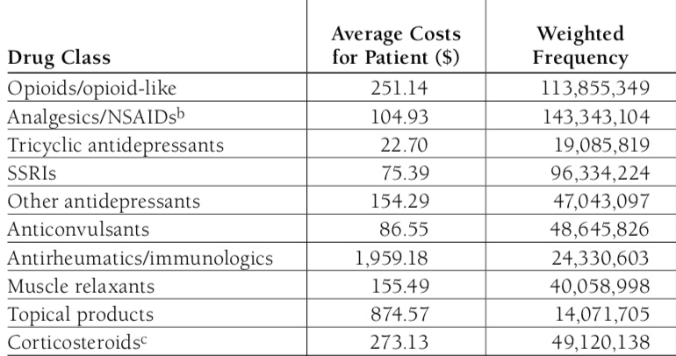
Costs of medications: The Low-Hanging Fruit of SCS economic impact
A typical regimen for chronic pain might include a sustained release drug, Oxycontin, a breakthrough drug, Percocet and a Neuromodulator, Neurontin

Slide 8
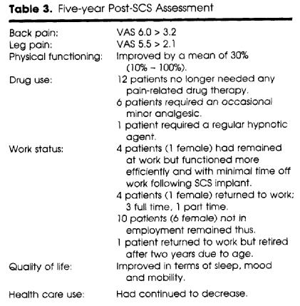
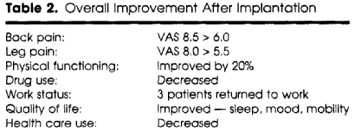
Budd K. Spinal Cord Stimulation: Cost-Benefit Study. Neuromodulation 2002;5:75-78
SCS: Cost Effectiveness Study
Cost-effectiveness reached at year 5 post implant

Slide 9
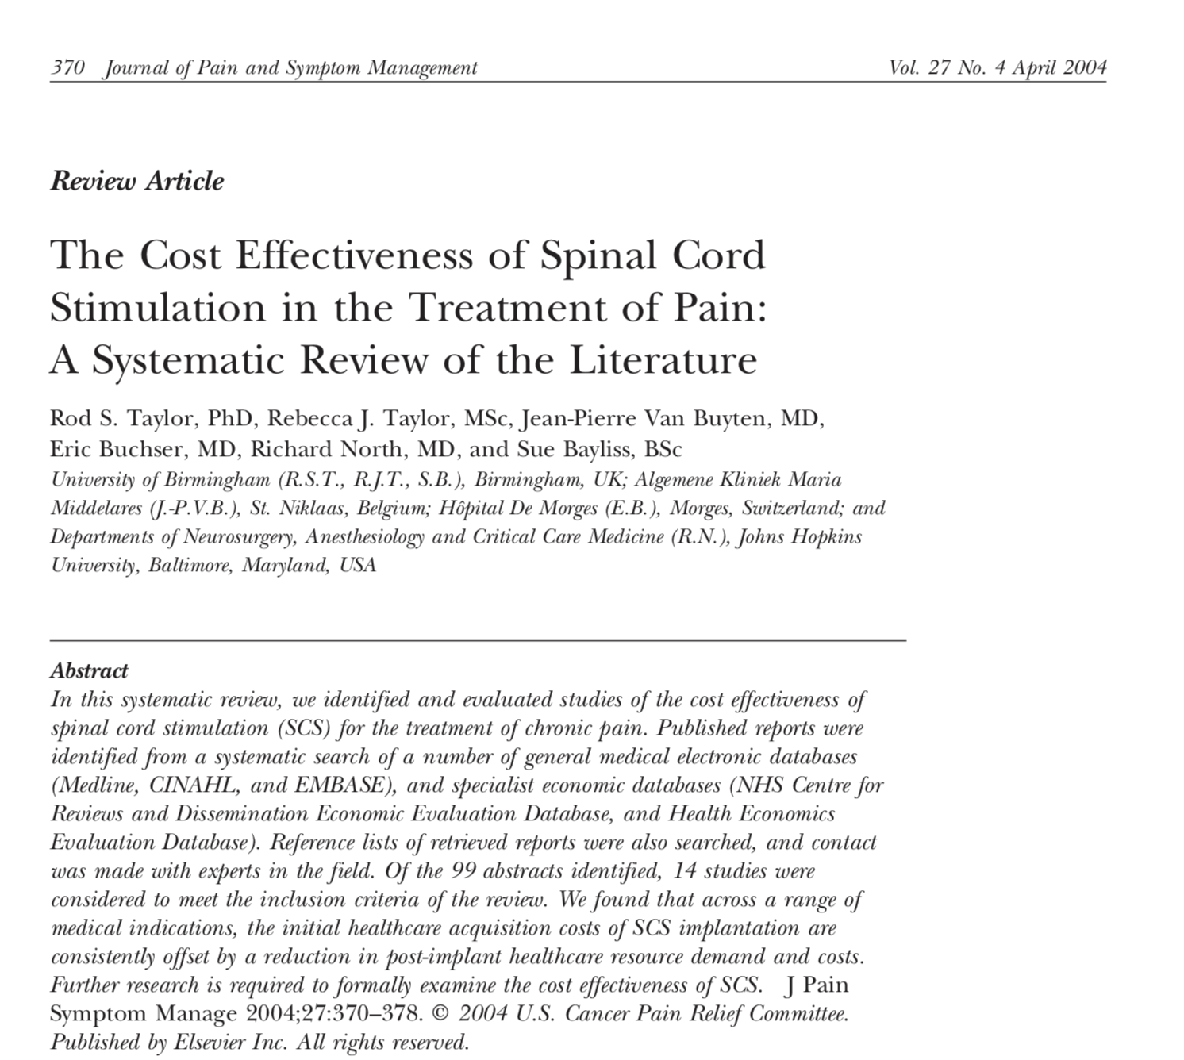
SCS: Cost Effectiveness Study
SCS cost effective within 3 years
FBSS, angina, CRPS
Drug costs, physician visits, hospitalization
$22, 500 per QALY----CRPS

Slide 10
SCS: Cost Effectiveness Study
North et al. 2007
By 3 years, patients who crossed over to SCS from re-do surgery had a cost of $118 K for good outcome
Those crossing over to re-operation did not have a good outcome despite a cost of $260K

Slide 11
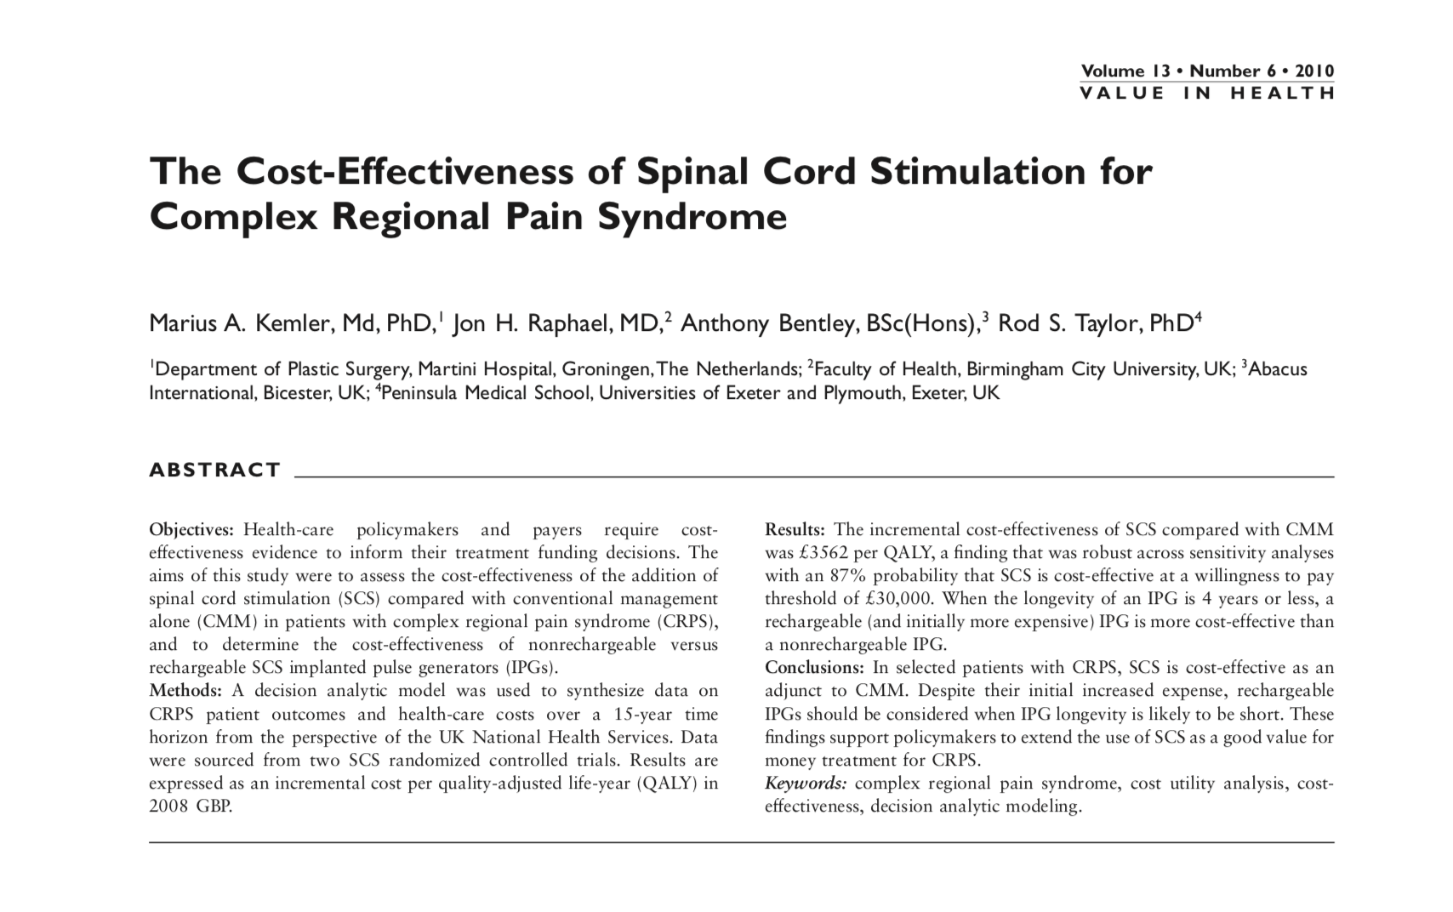
SCS: Cost Effectiveness Study
Advantage of SCS over CMM for CRPS 3562 GBP
SCS cost effective at 30K GBP per QALY
Rechargeable IPG more cost effective than primary cell that lasts 4 years or less

Slide 12
SCS: Cost Effectiveness Study
SCS more expensive than CMM or usual care
~$20-30K per 24 months
Workers’ Compensation patient population with FBSS
158 patients, less than 10% achieved any significant pain relief

Slide 13
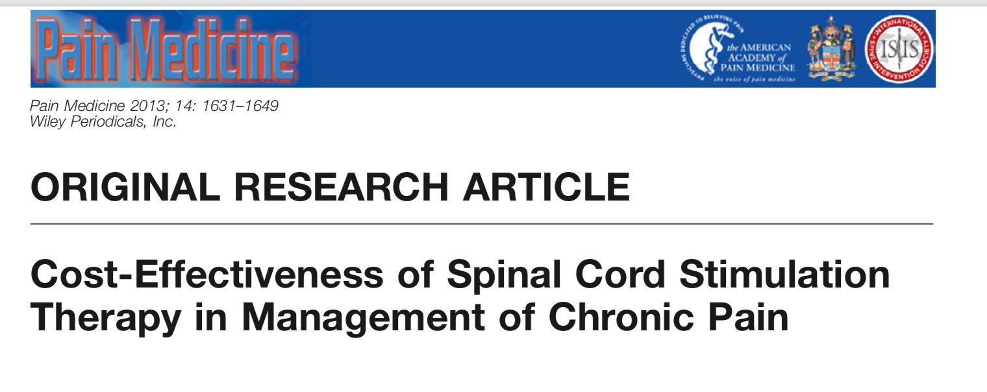
SCS: Cost Effectiveness Study
313 SCS
FBSS: 9293 CAN$ per QALY
CRPS: 11216 CAN$ per QALY
Angina: 9319 CAN$ per QALY
PVD: 9984 CAN$ per QALY

Slide 14
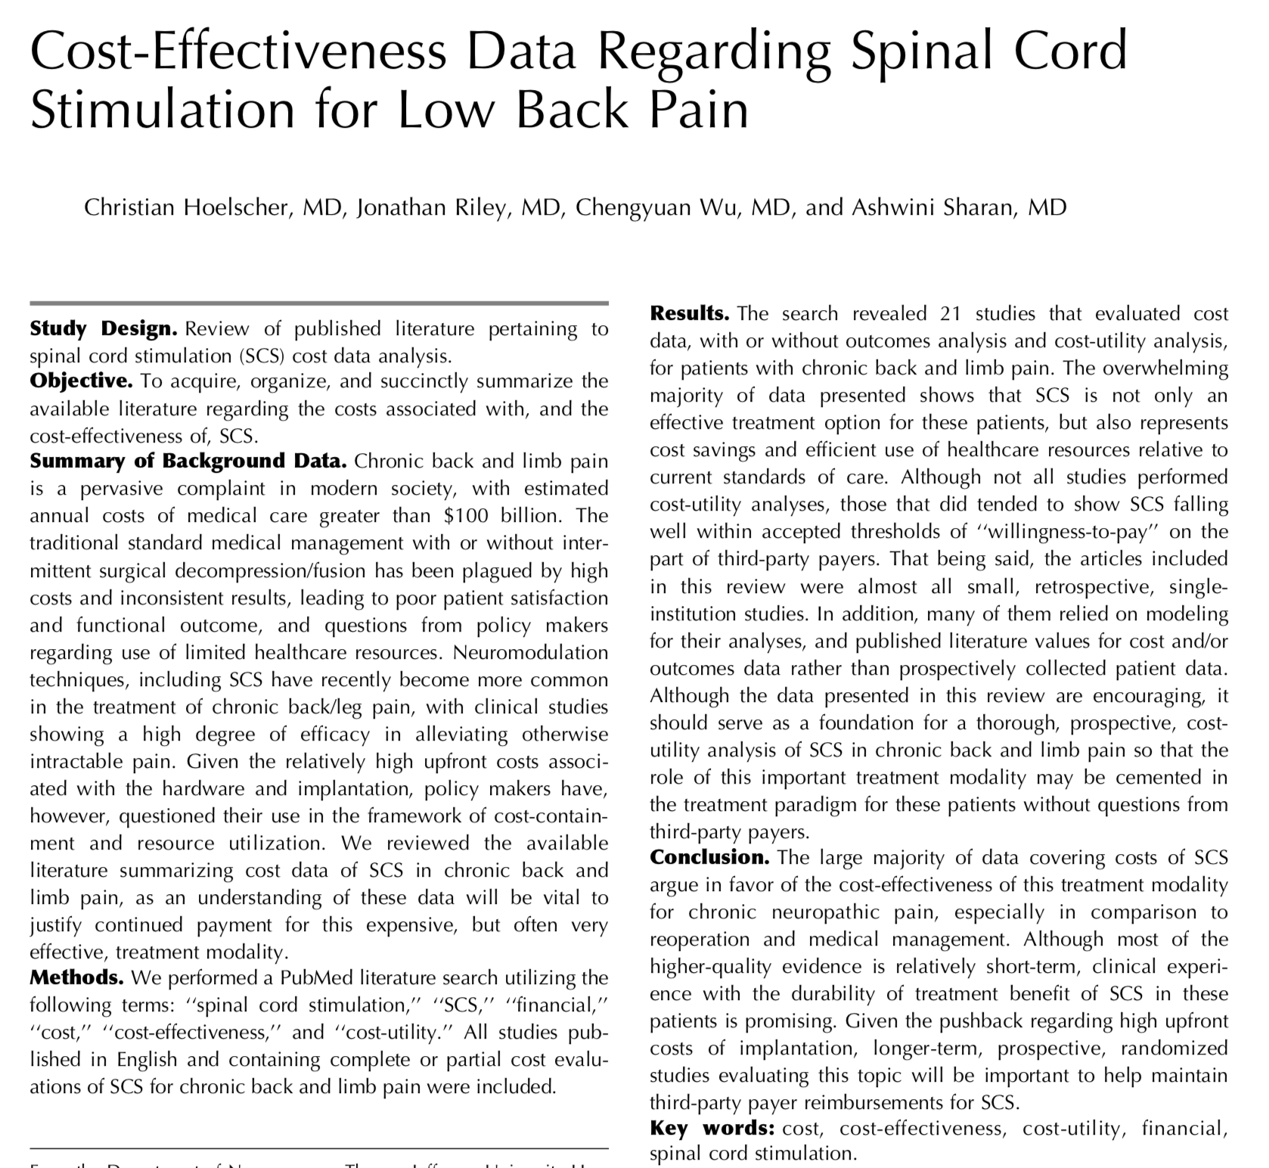
SCS: Cost Effectiveness Study

Slide 15
Economics and Clinical Trial Design
Notes:
There is a fundamental paradox in the current approach and understanding of psychiatric surgery
Initial insights have revealed that the circuitry of psychiatric disease is extremely complex, perhaps more so than our current understanding of movement disorders with:
Because the field itself is rapidly evolving, the circuitry of psychiatric disease is like very much like a moving target as more and more information becomes elucidated
Yet, given the state of the art regarding the technology of neuromodulation such as DBS electrodes, a constrained anatomic target must be identified in order to bring about a clinical effect
The paradox is. . .

Slide 16
Summary
Increasing resistance from third-party payors despite FDA approval
VNS for Depression (CMS non coverage in 2007)
DRG-stim doesn’t have its own code; many have deemed it “investigational”
Currently NO SCS system is covered completely by DRG or APC payments (Medicare/SSI)--$20K
EVERY HOSPITAL SYSTEM IS LOSING MONEY
Most SCS pivotal trials are 510(k)
Many are non-inferiority studies comparing against currently approved SCS devices/algorithms
SENZA (Nevro)
Algovita (Nuvectra)
SUNBURST (Abbott)
Notes:
Need more summary

Slide 17
Summary
What is the rationale for third party payors (or CMS) to pay for treatments that reach market merely by superseding a non-inferiority threshold?
If the vast majority of the literature suggests that SCS is cost effective, then why aren’t the for-profit payors tripping over themselves to pay/steer for SCS?
Poor quality of the available data
End points that include cost-savings data would facilitate reimbursement without the need/time for post-market studies
Notes:
Need more summary

