Slide 1
Systematic review of methodologic characteristics and outcomes in RCTs of SCS for pain
Ewan McNicol
Tufts University/MCPHS University
McKenzie Ferguson
Southern Illinois University Edwardsville
INITIATIVE ON METHODS, MEASUREMENT, AND PAIN ASSESSMENT
IN CLINICAL TRIALS/ INSTITUTE OF NEUROMODULATION/
INTERNATIONAL NEUROMODULATION SOCIETY
November 14-16, 2018

Slide 2
Objectives
Describe review process
Report analysis
Explain deficiencies in reporting and methodology
Discuss recommendations for future studies

Slide 3
Scoping review – our inclusion criteria
RCT
SCS for pain of any nature
Example comparators: sham, usual care, waiting list, surgery, pharmacotherapy, alternative type/frequency of SCS
Any pain outcome (primary or secondary)
Adults or adolescents
Blinded or unblinded
No minimum study duration
Any sample size
**CE evaluation will be conducted separately**

Slide 4
Search strategy
1. spinal cord stimulat$.ti,ab,kw.
2. dorsal column stimulat$.ti,ab,kw.
3. epidural stimulat$.ti,ab,kw.
4. or/1-3
5. exp PAIN/
6. pain*.mp.
7. (neuralgi* or myalgi* or neuropath* or arthriti* or osteoarthri* or arthralgi* or sciatica or headache* or migrain*).mp.
8. exp ANALGESIA/
9. analgesi*.mp.
10. exp Tibial Neuropathy/ or exp Femoral Neuropathy/ or exp Radial Neuropathy/ or exp Alcoholic Neuropathy/ or exp Optic Neuropathy, Ischemic/ or exp Median Neuropathy/ or exp Sciatic Neuropathy/
11. Critical limb ischemia.kw.
12. lower limb ischemia.kw.
13. leg ischemia.kw.
14. exp ATHEROSCLEROSIS/
15. exp Vascular Diseases/ or exp Peripheral Vascular Diseases/ or exp Peripheral Arterial Disease/ or exp Arteriosclerosis/ or exp Ischemia/ or exp Arterial Occlusive Diseases/
16. or/5-15
17. randomized controlled trial.pt.
18. controlled clinical trial.pt.
19. randomized.ab.
20. placebo.ab.
21. drug therapy.fs.
22. randomly.ab.
23. trial.ab.
24. groups.ab.
25. or/17-24
26. (animals not (humans and animals)).sh.
27. 25 not 26
28. 4 and 16 and 27
Notes:
MEDLINE

Slide 5
Prisma flow chart

Slide 6
Search results
Included Studies | 32 (study is the unit, not publication)
Excluded Studies | 64
Extension Studies | 7
Angina | 16
TOTAL | 119

Slide 7
Data extraction
Study features
Number and location of sites, registration
Funding sources
Inclusion criteria
Patients/Population
Study design
Crossover washout
Blinding and randomization
Trial phase
Intervention and control
Coadministration of other interventions
SCS adjustments
Ability for patients to crossover to other intervention
Duration
Primary and secondary outcomes – multiple?
Adverse events assessment
Statistics
Superiority/inferiority/equivalence
Power, sample size and effect size
Definition of clinical significance
ITT or PP? Dealing with missing data.
Reporting of Results
Number of participants enrolled/completed/included in analysis
Demographics and similarity between groups
Reporting of primary and secondary analyses
% of participants requiring adjustments due to AEs

Slide 8
Data extraction - disagreements
Each study extracted in duplicate
Mean 18 (range 4-36) per extraction (cf Cochrane reviews)
Nature of the review, deficiencies in coding manual, lack of reviewer knowledge, or weaknesses in reporting?
Common disagreements
Role of sponsor
Type of analysis: superiority, etc.
PR vs PID
Clinical significance
Notes:
~60 questions, some of which had multiple options

Slide 9
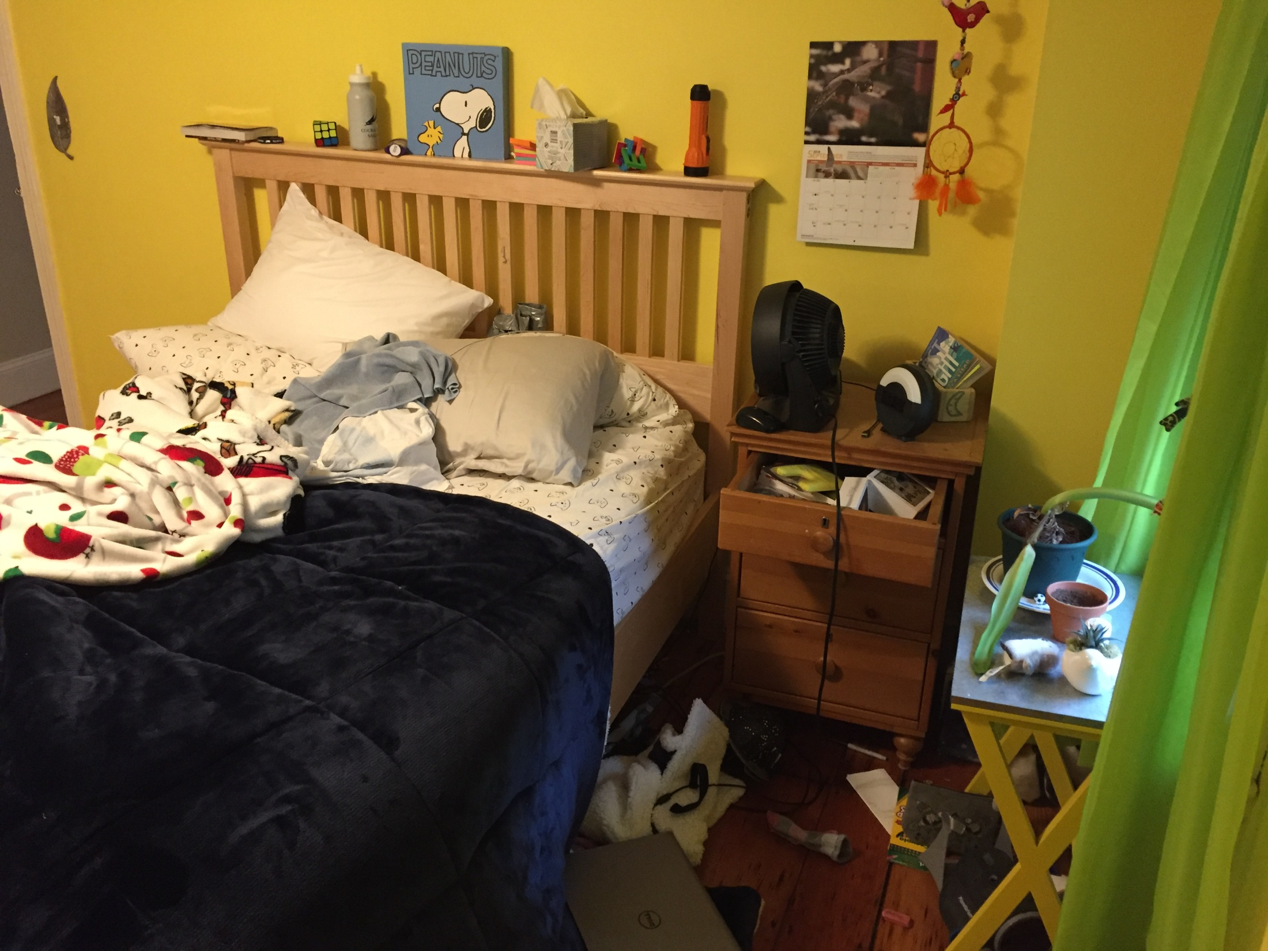
Analysis

Slide 10
Study features
# Sites | 47% single-center; 53% multicenter
Sites in U.S. | 34% included U.S. (11/32)
Registered studies | 38% (12/32)

Slide 11
Inclusion criteria

Slide 12
Inclusion criteria: requirement for minimum pain intensity or duration
 | Minimum Pain Intensity (0 to 10) | Minimum Pain Duration (months)
# Studies | 12 | 17
Average | 5.15 | 6.65
Median | 5 | 6

Slide 13
Patient population (per inclusion criteria)
Angina n=16 (not yet reviewed)
Notes:
Emphasize that this is per inclusion criteria – details in results would show what pts actually had, e.g., FBSS could be part of inclusion criteria, or only back pain and the demographics might then reveal that many pts had FBSS
Need to separate leg pain due to radiculopathy from pain due to limb ischemia. Also, most pt’s with PVD also have leg pain.

Slide 14
Design characteristics
41% parallel (13/32)
59% crossover (19/32)
Duration of washout specified in 79% (15/19)
Range 0-2 weeks
Mode = 0
72% of studies open-label (23/32)
Of the 9 with blinding:
8 blinded participants, 5 outcome assessors & 6 investigators
2/9 with high risk of bias; 5/9 with low risk of bias; 2 unclear risk
Randomization
72% (23/32) low risk of bias, 7/32 unclear; 2 high risk
53% (17/32) trial/screening phase
63% (20/32) allowed for SCS adjustments
11 allowed for adjustments in all arms of the study
8 only in the intervention arm
1 only in the control arm
Notes:
Should make this more graphic

Slide 15
Design characteristics: Interventions (n=32)

Slide 16
Design characteristics: Controls (N = 36)
Notes:
PT = 2
DRG = 1
HF = 1
Burst = 1
Numbers do not add to 32 as more than one control in some studies

Slide 17
Design characteristics: Adjustments allowed?
Adjustments Specified | Number of Studies
Amplitude | 18
Electrode location | 5
Frequency | 5
Pulse width | 5
Not specified | 6
On/Off | 4
Combination of > 1 | 12

Slide 19
Design characteristics: Timing
Total duration of intervention
Median 12 weeks (range 0 to 208)
Timing of the assessment of primary outcome
Mean 26 weeks (SD 46)
Median 12 weeks (range 0 to 208 weeks)

Slide 20
Design characteristics: Primary outcomes
Specified in 94% of studies (30/32)
10% (3/30) not related to pain (amputation, limb survival, battery life)
37% (11/30) had multiple primary outcomes
63% (19/30) had pain intensity as the primary outcome or a component of primary outcome(s)
73% (22/30) discussed paresthesia: majority of the time was discussed as part of study methods

Slide 21
Design characteristics: Components of Multiple Primary Outcomes (N=11 studies)
Pain intensity | 8
Pain relief | 2
Patient satisfaction | 2
No neurological deficit | 2
Multidimensional pain questionnaire (e.g., McGill) | 1
HRQoL | 1
PGIC | 1
Responder analysis | 1
*36% (4/11) specified adjustment indicated for multiplicity (e.g., alpha adjustment, requirement that all tests be significant, etc.)

Slide 22
Design characteristics: Secondary/exploratory outcomes

Slide 23
Design characteristics: Adverse Events
Two studies assessed AEs as a primary outcome
44% (14/32) studies prespecified AEs as an outcome & 44% reported serious AEs
Most studies did not clearly specify how AEs were collected (i.e., actively, passively or both)
69% (22/32) of studies did not clearly state the # of participants who needed to have adjustments to their regimen due to AEs

Slide 24
Statistical analysis
Half of the studies were superiority (16/32); 11 studies did not specify
Four studies were noninferiority
One was equivalence
 | Power (%) | Pre-specified effect size | Sample size
Yes | 18 | 17 | 19
No | 14 | 15 | 13

Slide 25
Statistical analysis: Clinical significance

Slide 26
Statistical analysis: Population analysis
 | Intention to Treat (ITT) | Per-Protocol | Both
# of Studies | 11 (34%) | 18 (56%) | 2 (6%)
*One study was designated unclear; 5 ITT studies has a method to accommodate missing data

Slide 27
Results: Participant demographics
Mean N of 50 participants in the primary analysis
Mean age 55
40% female
59% (19/32) had no information stated about similarity between groups or it was unclear

Slide 28
Reporting of primary and secondary outcomes
To follow.......
But, essentially a big mix of # of responders, mean change within groups, mean difference between groups, etc.

Slide 29
Results: adverse events

Slide 30
Extension studies
7 extensions of included RCTs
Outcomes from 6 months up to 5 years
Assessed secondary outcomes or secondary endpoints of primary outcomes
Will add to final analysis

Slide 31
Observations
We were not familiar with SCS or the literature – we might have set up Qs differently
Timeline:
SCS vs. usual care
adjustments in conventional SCS
burst/HF SCS vs. conventional SCS or other burst/HF settings
Technical vs. clinical studies
“Conventional” SCS may not be homogeneous. Are comparisons of HF/burst with conventional fair comparisons?
Small sample sizes, short durations.
Clinically meaningful: both within patient and between groups
Notes:
if patients were already using an SCS before randomization, this does NOT count as a trial phase.

Slide 32
Points for discussion
Include angina studies?
Include DRG studies?
Location vs. diagnosis
Different outcomes for SCS studies vs. pharmacotherapy studies?
Reasonable study sample size?
Reasonable study durations? Can these be offset by extensions?
Crossover vs. parallel?
Notes:
Crossover requires less pts, parallel less time
Only two DRG studies and comparison was SCS in both, so number of studies will stay the same regardless of decision

Slide 33
Acknowledgments
Thanks to our co-reviewers: Emily Rowe and Kathy Bungay
Thank you to Jennifer Gewandter and Shannon Smith for help in setting up our questionnaire and in presenting our results

